Slide 1


Agent-Based Modeling of Public Transport Optimization under Flood Scenarios RAMP team Resilience, ABM & Multi-network Prototyping

Slide 2
Team Members
Milan Schabort D-ITET, Elektrotechnik und Informationstechnologie MSc
Oleksandr Halipchak
D-BAUG, Raumentwicklung und Infrastruktursysteme MSc
Tonggui Zhang
D-BAUG, D-BAUG, Doktorat Infrastructure Management

Slide 3
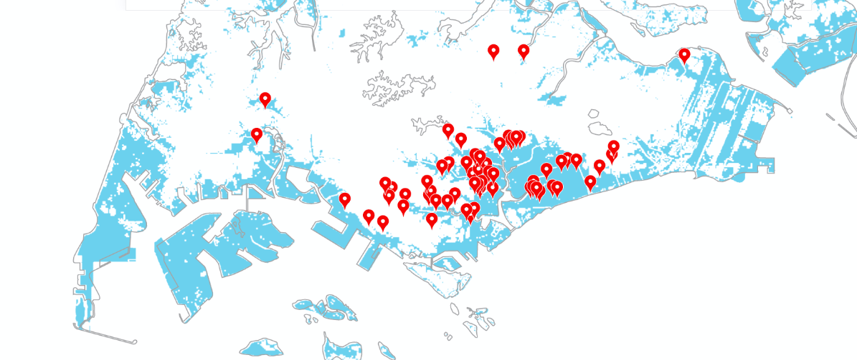
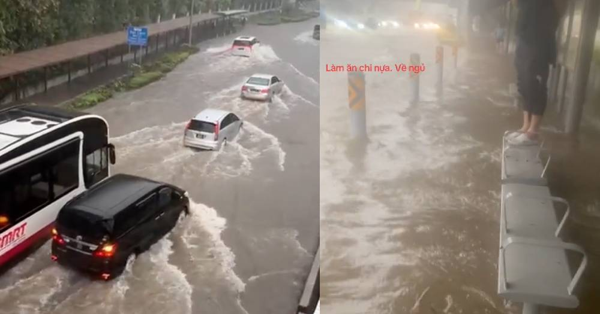
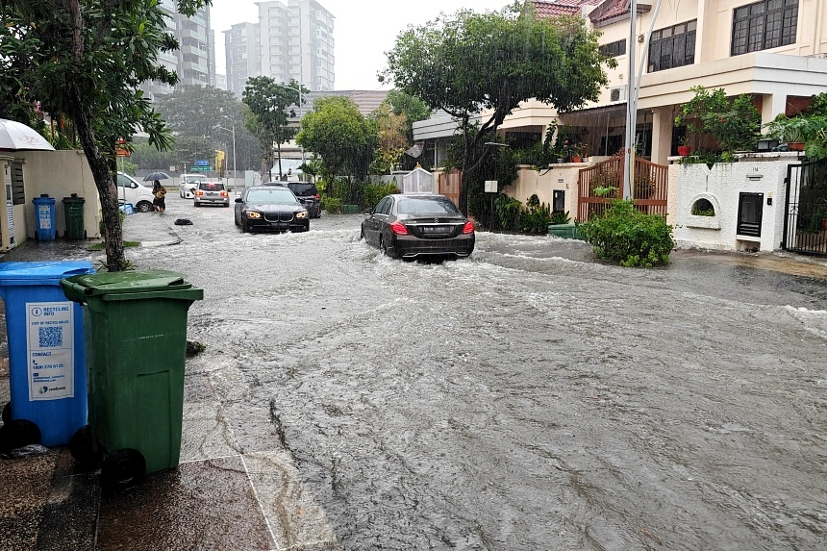
Resilience Challenges: Urban Flooding in Singapore
In 2024, Singapore recorded unprecedented rainfall events, breaking monthly and annual precipitation records and triggering flash floods in areas such as Tampines and Bukit Timah [1].
Heavy downpours on 29 December 2024 caused severe flash floods in Bukit Timah, inundating major thoroughfares and stranding vehicles [4].
Recurrent flooding has placed growing strain on Singapore’s flood-mitigation infrastructure, escalating maintenance and repair costs for PUB and related agencies [5]
2024 Several areas in Singapore were flooded on Oct. 14 due to heavy rains that started at midnight.
Source：Lianhe zaobao
The Straits Times, “2024 Singapore weather breaks temperature and rainfall records in 2024: MSS report,” Apr. 2025.
The Straits Times, “Risk of flash floods from Jan 10 to 13, PUB & NEA warn,” Jan. 2024.
Channel NewsAsia, “Heavy rain triggers flash flood warnings across Singapore,” May 4, 2024.
The Straits Times, “Flash floods in Bukit Timah following afternoon deluge,” Dec. 29, 2024.
Channel NewsAsia, “IN FOCUS: Can Singapore’s multibillion-dollar flood-proofing efforts keep up with climate change?,” Mar. 2025.

Slide 4
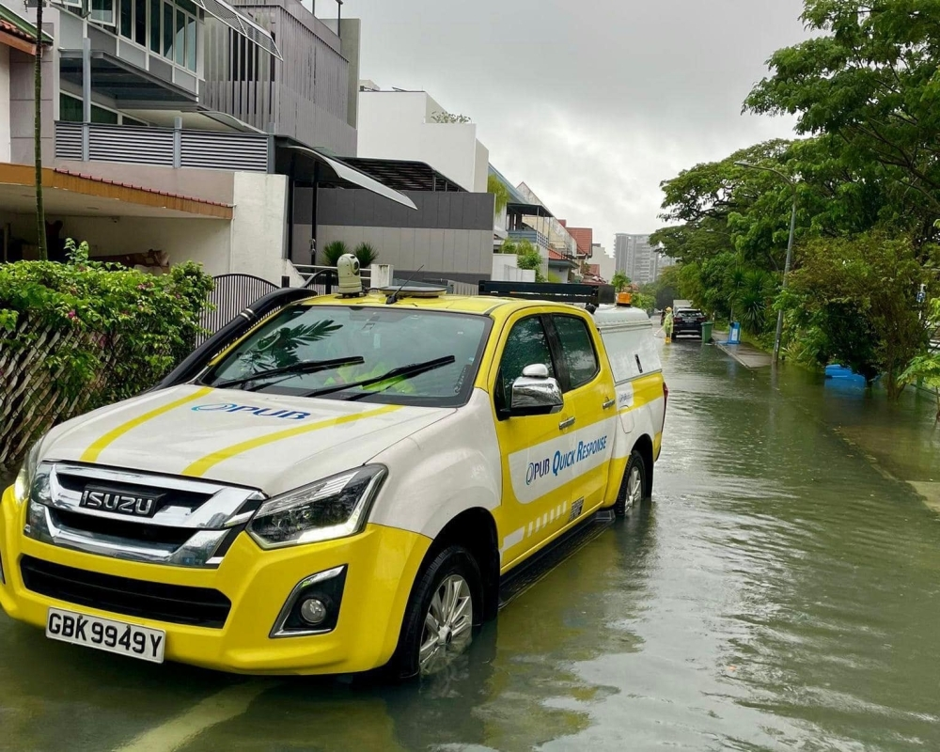
Existing Approaches & Limitations
Approaches:
Passive infrastructure: drains, detention tanks, rain gardens mitigate routine flooding [1][2]
Reactive recovery: pumps & crews clear major roads in ~2–4 h, but lack network-wide prioritisation [3]
Algorithmic sequencing: resilience-based repairs cut recovery time by ~20 % [4][5]
Limitations：
Hazard models rely on simplified assumptions; lack of high-quality input data can skew flood extent predictions
Traffic recovery strategies often use synthetic or aggregated flows; need real-world traffic parameter.
A PUB Quick Response Team vehicle responded to the flooding along Jalan Seaview on Janueary 10, 2025. — Picture from Facebook/PUB
PUB, Managing Urban Runoff: Drainage Handbook, PUB, Apr. 2024. PUB, Singapore’s National Water Agency
PUB, Annual Report 2019, “Stamford Detention Tank project can temporarily store up to 15 Olympic-sized pools (~38 000 m³)”, 2019. PUB, Singapore’s National Water Agency
Channel NewsAsia, “Flash floods at four locations amid heavy rain”, Apr. 20, 2025. Flooding subsided after about an hour at all four locations. CNA
Liu, Y. C., McNeil, S., Hackl, J., & Adey, B. T., “Prioritizing transportation network recovery using a resilience measure”, Sustainable and Resilient Infrastructure, vol. 7, no. 1, pp. 70–81, Jan. 2022. Complex Infrastructure Systems
Pan, X., Dang, Y., Wang, H., Hong, D., Li, Y., & Deng, H., “Resilience model and recovery strategy of transportation network based on travel OD-grid analysis”, Reliability Engineering & System Safety, vol. 223, 108483, 2022. doi:10.1016/j.ress.2022.108483.

Slide 5
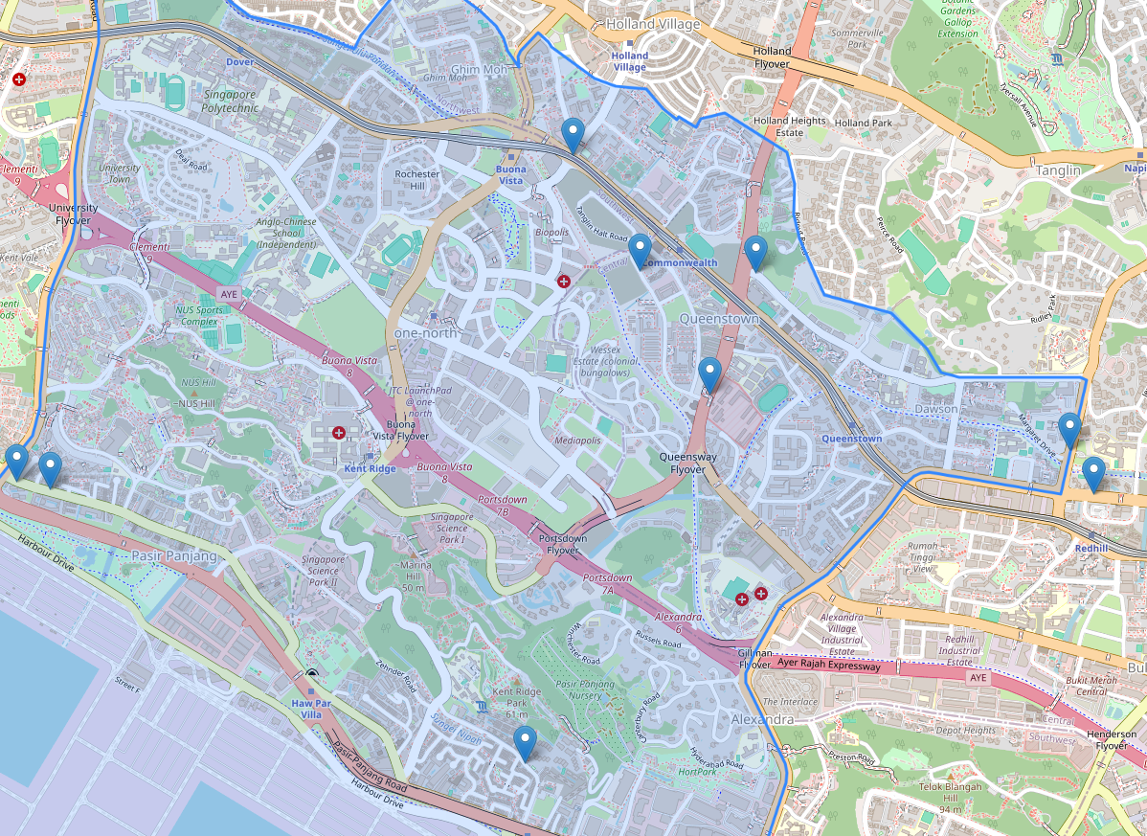
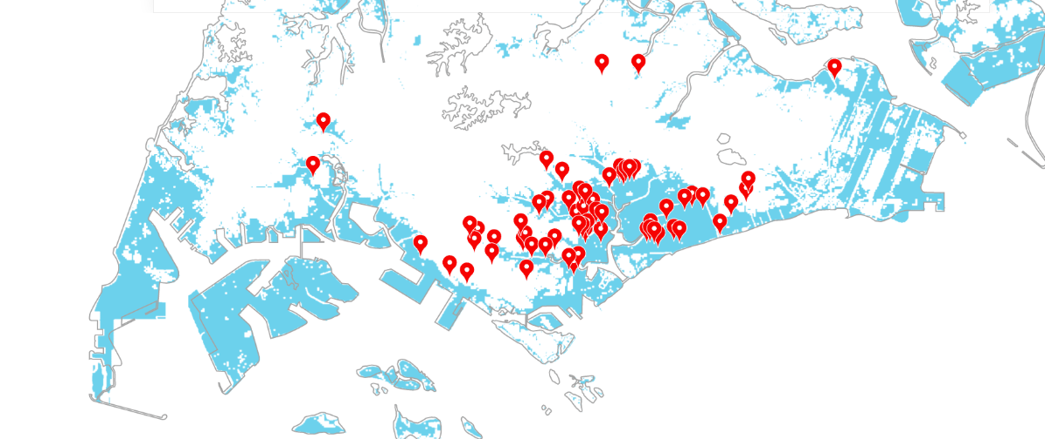
Flood in Singapore
Ayer Rajah Expressway: May expressway crosses the whole Queenstown area.
PHOTO: LIANHE ZAOBAO READER Nov 22 2024
Singapore Flood Prone Areas
Source：Lianhe zaobao

Slide 6
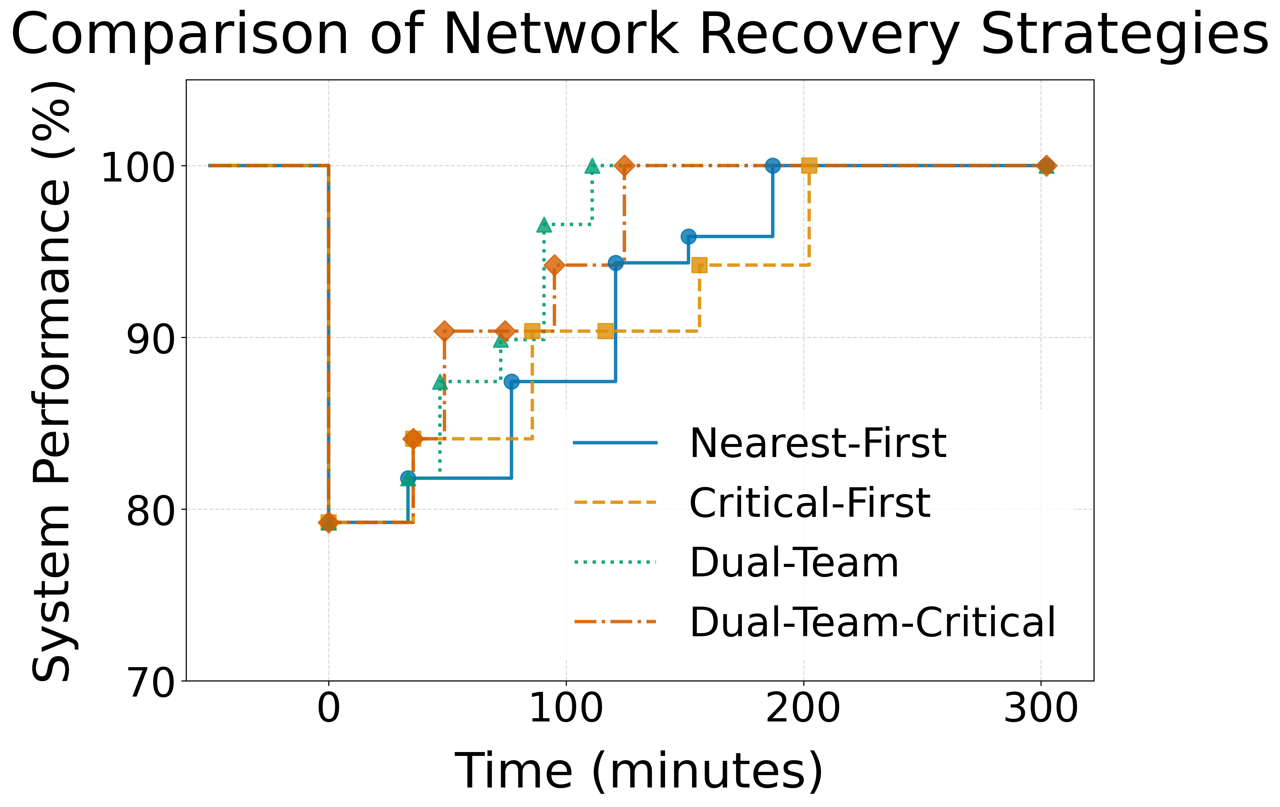
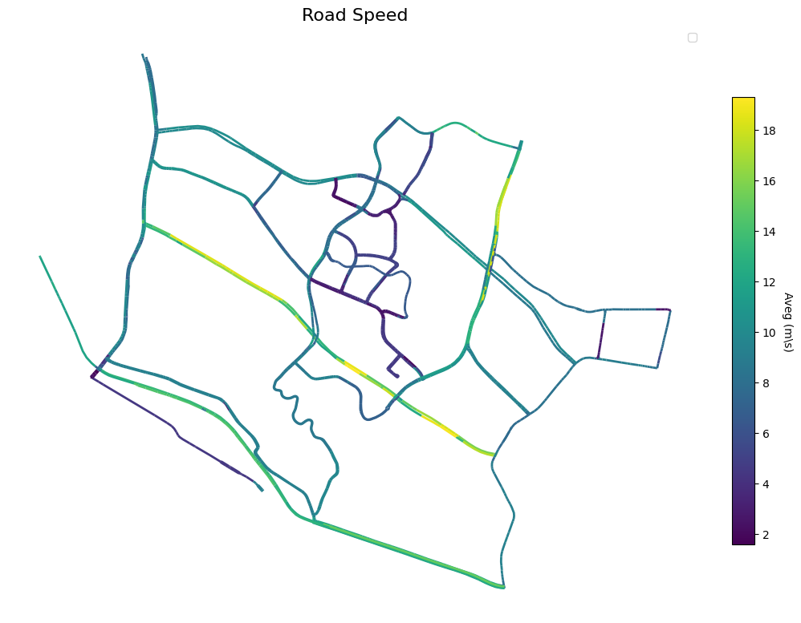
Workflow
Network Resilience Layer (NRL)
Information input
Performance Analysis
Scenario Definition
System Modeling
Calibration
ABM Simulation
Decision support
Sensitivity Analysis
Validation
Scenario definition, validation, and sensitivity analysis will be explained in detail in the following slides.

Slide 7
Methodology & Framework
Hazard Module • Flood‐inundation modelling via LISFLOOD‐FP (DEM, rainfall, roughness inputs)
Infrastructure Module • Queenstown road network graph (nodes, links, capacity & hierarchy annotations)
Main Simulator
Baseline traffic: compute original network state by assigning multi-OD travel demands and deriving travel times
Damage assessment: overlay flood inundation to identify impaired links
Recovery sequence: apply restoration strategy step-by-step
Performance update: recalculate connectivity, travel time & resilience metrics
Recovery Module • Four strategies – Nearest-First, Critical-First, Dual-Team, Dual-Team-Critical – sequenced by resilience index (MNRI)
[1] Neal, J., Schumann, G., & Bates, P. D. (2012). A subgrid channel model for simulating river hydraulics and floodplain inundation. Water Resources Research, 48. [2] University of Bristol. (2014). LISFLOOD-FP User Manual v5.9.5. [3] Liu, Y. C., McNeil, S., Hackl, J., & Adey, B. T. (2020). Prioritizing transportation network recovery using a resilience measure. Sustainable and Resilient Infrastructure, 7(1), 70–81.

Slide 8




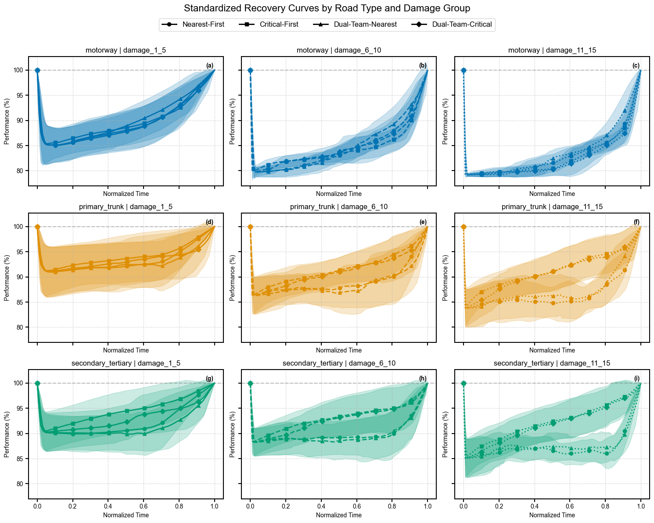
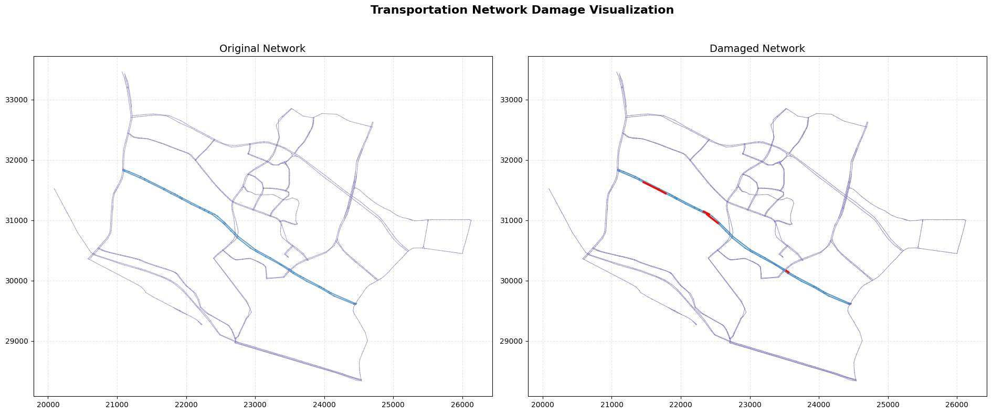
Network Resilience Layer (NRL)
Methodology & Framework
Road‐network node topology
Network connectivity reconfiguration
Morning‐peak OD travel‐time matrices
Flood‐model probability matrices
Hierarchical recovery‐strategy definitions
Simulation results for each road under various damage levels
Recovery
Strategies
Recovery
module
Phase
update
Historical
Data
Sequence
Power
Traffic
data
Infrastructure module
Components status
Main simulator
Performance matrix
Connectivity component
Damaged components
Hazard
module
Flood Hydraulics

Slide 9
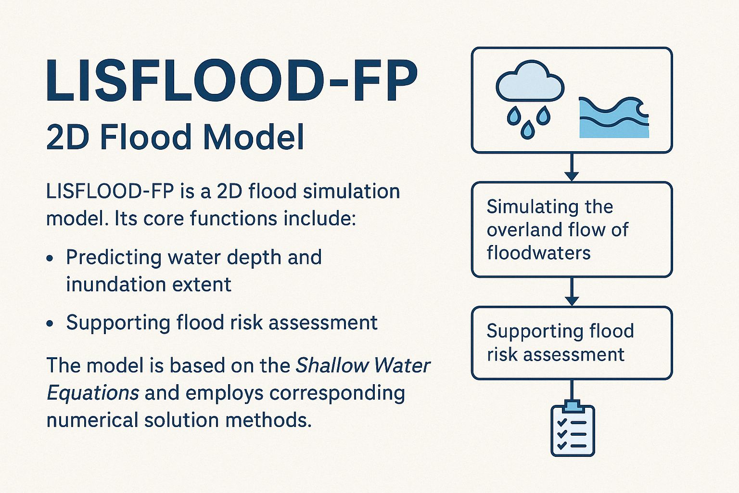
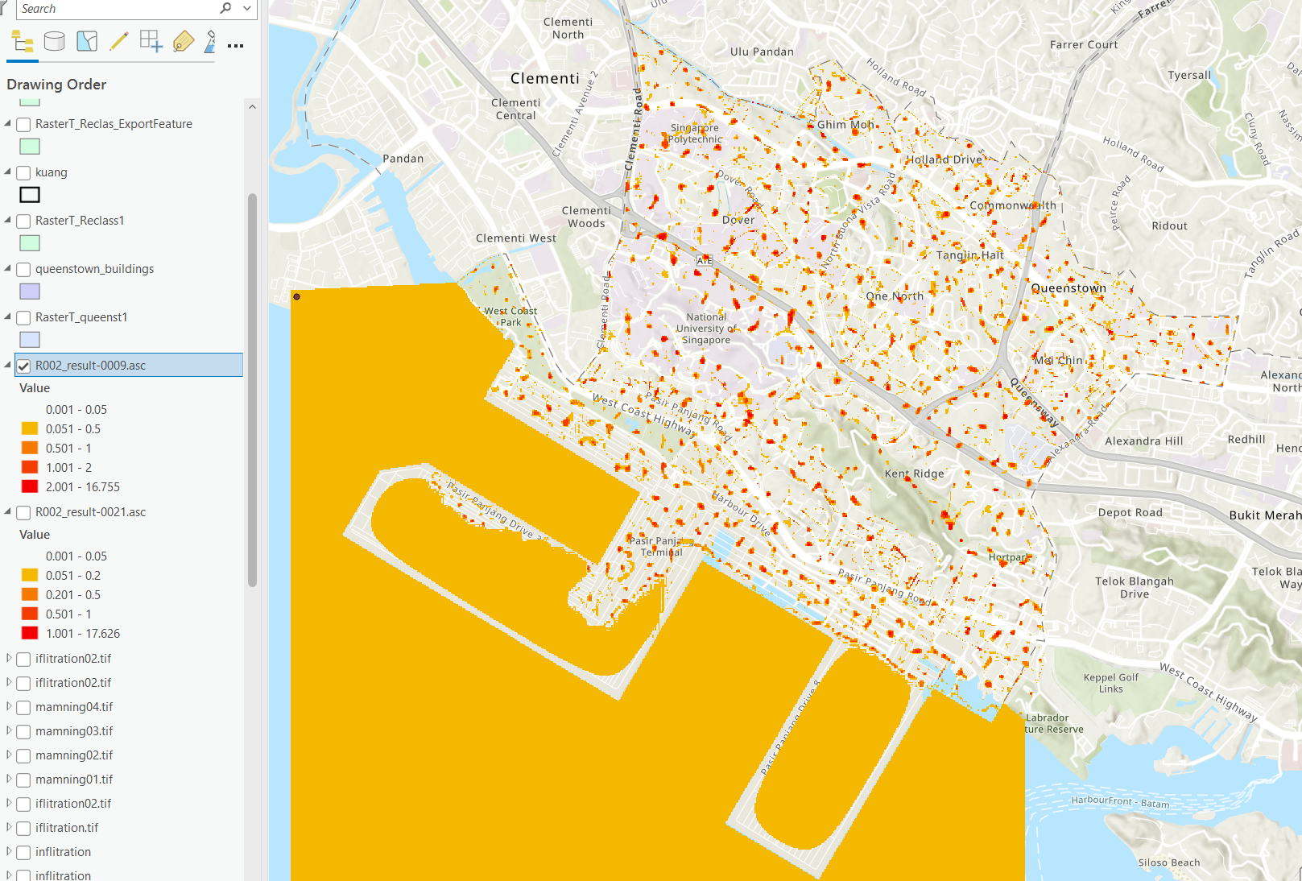
Hazard Module
Input Data Preparation (DEM, rainfall, surface roughness) → Grid Generation & Initial Condition Setup → Explicit Finite Difference Method for Solving Shallow Water Equations (Calculate changes in water depth and flow velocity at each time step for each grid) → Output Generation (Time-series water depth data)
[1] Neal, J., Schumann, G., & Bates, P. D. (2012). A subgrid channel model for simulating river hydraulics and floodplain inundation. Water Resources Research, 48. [2] University of Bristol. (2014). LISFLOOD-FP User Manual v5.9.5.

Slide 10
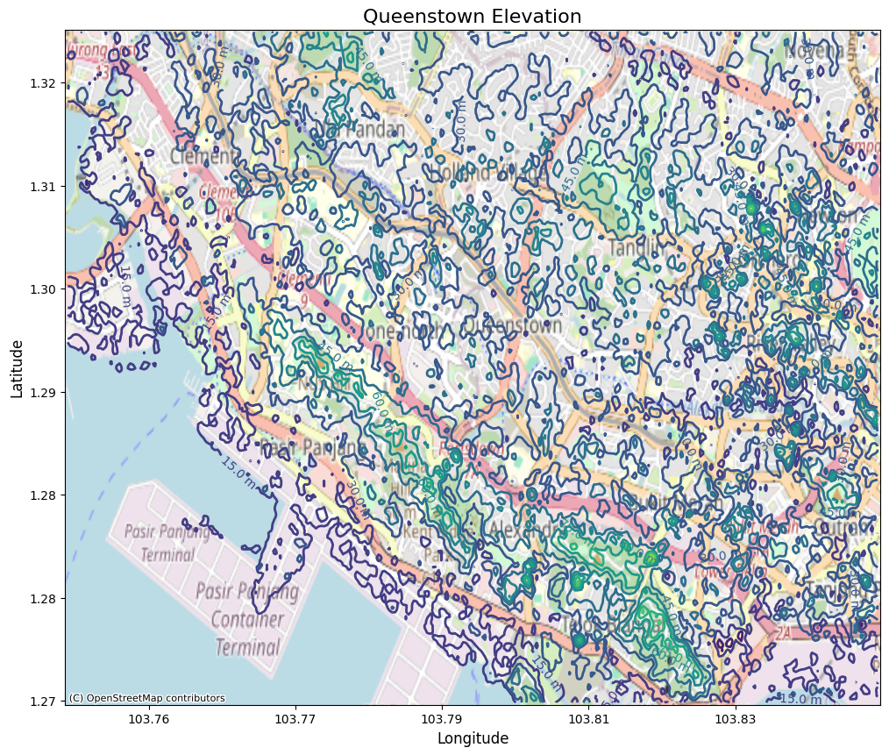
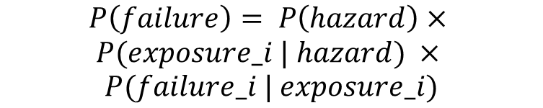
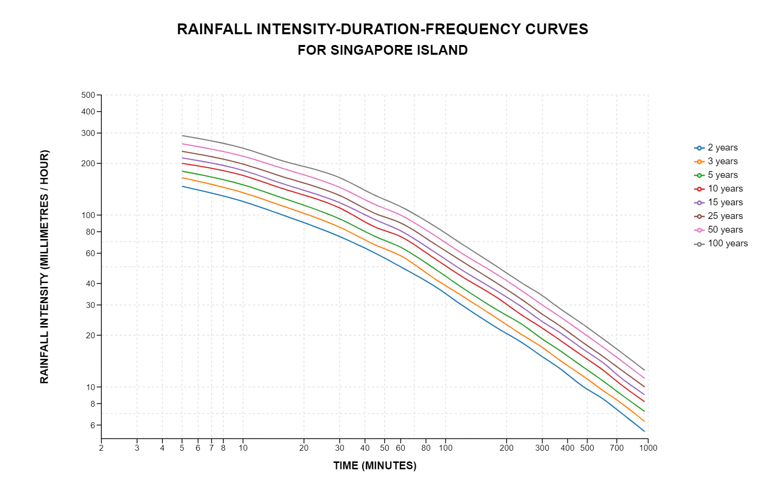
Interdependent infrastructure
flow-based simulation model
Hazard module
Probabilistic Risk Assessment:
P(hazard) represents the probability of the hazard itself. The probability of a 50-year flood event (not directly influenced by terrain elevation).
P(exposure_i | hazard) is the conditional probability that component i will be exposed. Flood exposure is determined by elevation differences, with lower areas (from an elevation matrix) being more at risk.
P(failure_i | exposure_i) is the conditional probability of failure if exposed. The likelihood of failure depends on infrastructure capacity.
Notes:
The hazard model simulates how disruptions, specifically floods, impact critical infrastructure networks by leveraging flood tracks derived from GPS data. These tracks provide the real-time path of a flood, allowing us to accurately map its movement. Each hazard is characterized by its intensity—ranging from 'low' to 'extreme'—which influences the failure probability of infrastructure components.
The flood events are modeled with assumptions about the affected area (floodplains are considered to be within 100 meters of the main water stream). Different flood intensities (low, moderate, and high) have specific probabilities of occurrence (0.1, 0.3, and 0.5, respectively). The failure probabilities are computed using these intensities. For instance, if an infrastructure component is exposed to a high-intensity flood, the conditional failure probability is 0.6.
Here, p(hazard)p(hazard) represents the probability of the hazard itself, p(exposurei∣hazard)p(exposurei​∣hazard) is the conditional probability that component ii will be exposed to the hazard if it occurs, and p(failurei∣exposurei)p(failurei​∣exposurei​) is the conditional probability of failure of component ii if it is exposed to the hazard.
The simulated events are used to derive the direct impacts, such as infrastructure component failures, and indirect effects, such as disruptions propagated through interdependencies among infrastructure systems​
Using the GPS-defined flood paths, we determine which infrastructure components—like power lines, water pipes, and transportation nodes—fall within the buffer zones of the flood's reach. By calculating the proximity to the flood's centerline, we dynamically assign failure probabilities based on both the distance and intensity of the hazard. The primary goal is to capture the realistic spread of the flood and its cascading impact on interdependent systems, ensuring we understand how infrastructure failures might propagate through the network.

Slide 11
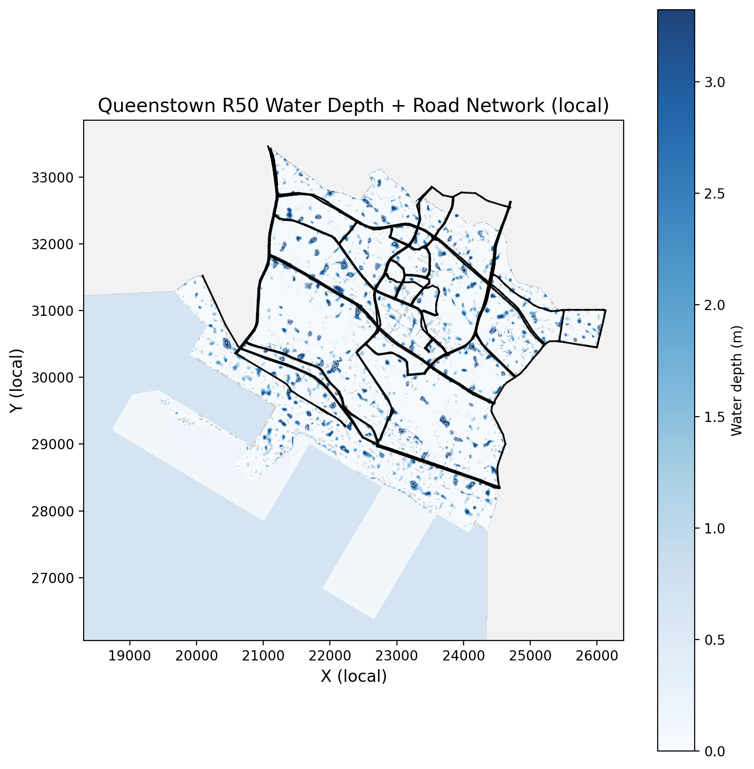
Interdependent infrastructure
flow-based simulation model
Hazard module
Probabilistic Risk Assessment:
P(hazard) represents the probability of the hazard itself. The probability of a 50-year flood event (not directly influenced by terrain elevation).
P(exposure_i | hazard) is the conditional probability that component i will be exposed. Flood exposure is determined by elevation differences, with lower areas (from an elevation matrix) being more at risk.
P(failure_i | exposure_i) is the conditional probability of failure if exposed. The likelihood of failure depends on infrastructure capacity.
Notes:
The hazard model simulates how disruptions, specifically floods, impact critical infrastructure networks by leveraging flood tracks derived from GPS data. These tracks provide the real-time path of a flood, allowing us to accurately map its movement. Each hazard is characterized by its intensity—ranging from 'low' to 'extreme'—which influences the failure probability of infrastructure components.
The flood events are modeled with assumptions about the affected area (floodplains are considered to be within 100 meters of the main water stream). Different flood intensities (low, moderate, and high) have specific probabilities of occurrence (0.1, 0.3, and 0.5, respectively). The failure probabilities are computed using these intensities. For instance, if an infrastructure component is exposed to a high-intensity flood, the conditional failure probability is 0.6.
Here, p(hazard)p(hazard) represents the probability of the hazard itself, p(exposurei∣hazard)p(exposurei​∣hazard) is the conditional probability that component ii will be exposed to the hazard if it occurs, and p(failurei∣exposurei)p(failurei​∣exposurei​) is the conditional probability of failure of component ii if it is exposed to the hazard.
The simulated events are used to derive the direct impacts, such as infrastructure component failures, and indirect effects, such as disruptions propagated through interdependencies among infrastructure systems​
Using the GPS-defined flood paths, we determine which infrastructure components—like power lines, water pipes, and transportation nodes—fall within the buffer zones of the flood's reach. By calculating the proximity to the flood's centerline, we dynamically assign failure probabilities based on both the distance and intensity of the hazard. The primary goal is to capture the realistic spread of the flood and its cascading impact on interdependent systems, ensuring we understand how infrastructure failures might propagate through the network.

Slide 12
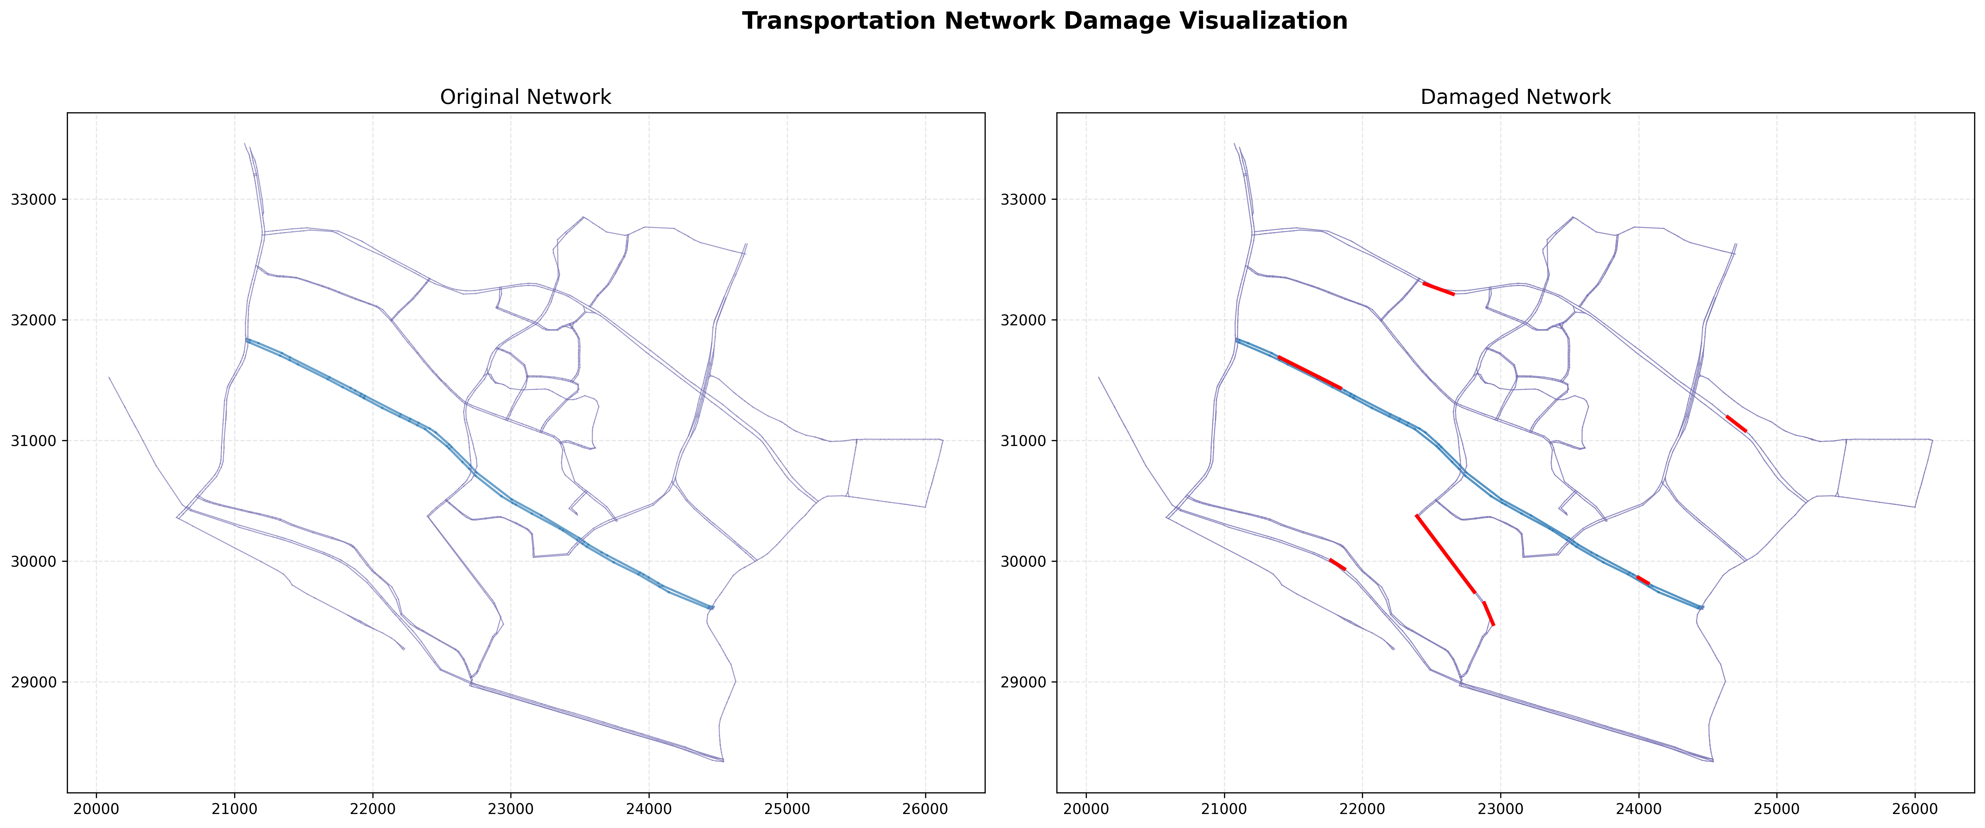
Damage and Recovery

Slide 13
Calculation of Travel Times on Traffic Segments
Average Speed in Morning Peak
Collected speed data for each small road segment during morning peak hours.
Computed travel time by dividing segment length by average speed.
OD Matrix of Travel Times
Constructed an Origin-Destination (OD) matrix using the calculated travel times between key points.
Shortest Path Analysis
Applied a single-source Dijkstra algorithm, using travel time as the weight (time = weight).

Slide 14
Recovery Agent Strategies
Nearest-First Repair the flooded link closest to crew location
Very fast – Myopic, ignores global impact
Critical-First Repair link with highest Δperformance/repair time ratio
Balances impact vs. effort – Requires weight tuning
Dual-Team (NN/Critical) Two crews pull tasks in parallel via priority queue
Exploits concurrency – Coordination overhead, no global optimum
[1] Neal, J., Schumann, G., & Bates, P. D. (2012). A subgrid channel model for simulating river hydraulics and floodplain inundation. Water Resources Research, 48. [2] University of Bristol. (2014). LISFLOOD-FP User Manual v5.9.5.

Slide 15
Network Resilience Layer (NRL)
Methodology & Framework
Road‐network node topology
Network connectivity reconfiguration
Morning‐peak OD travel‐time matrices
Flood‐model probability matrices
Hierarchical recovery‐strategy definitions
Simulation results for each road under various damage levels
Recovery
Strategies
Recovery
module
Phase
update
Historical
Data
Sequence
Power
Traffic
data
Infrastructure module
Components status
Main simulator
Performance matrix
Connectivity component
Damaged components
Hazard
module
Flood Hydraulics

Slide 16
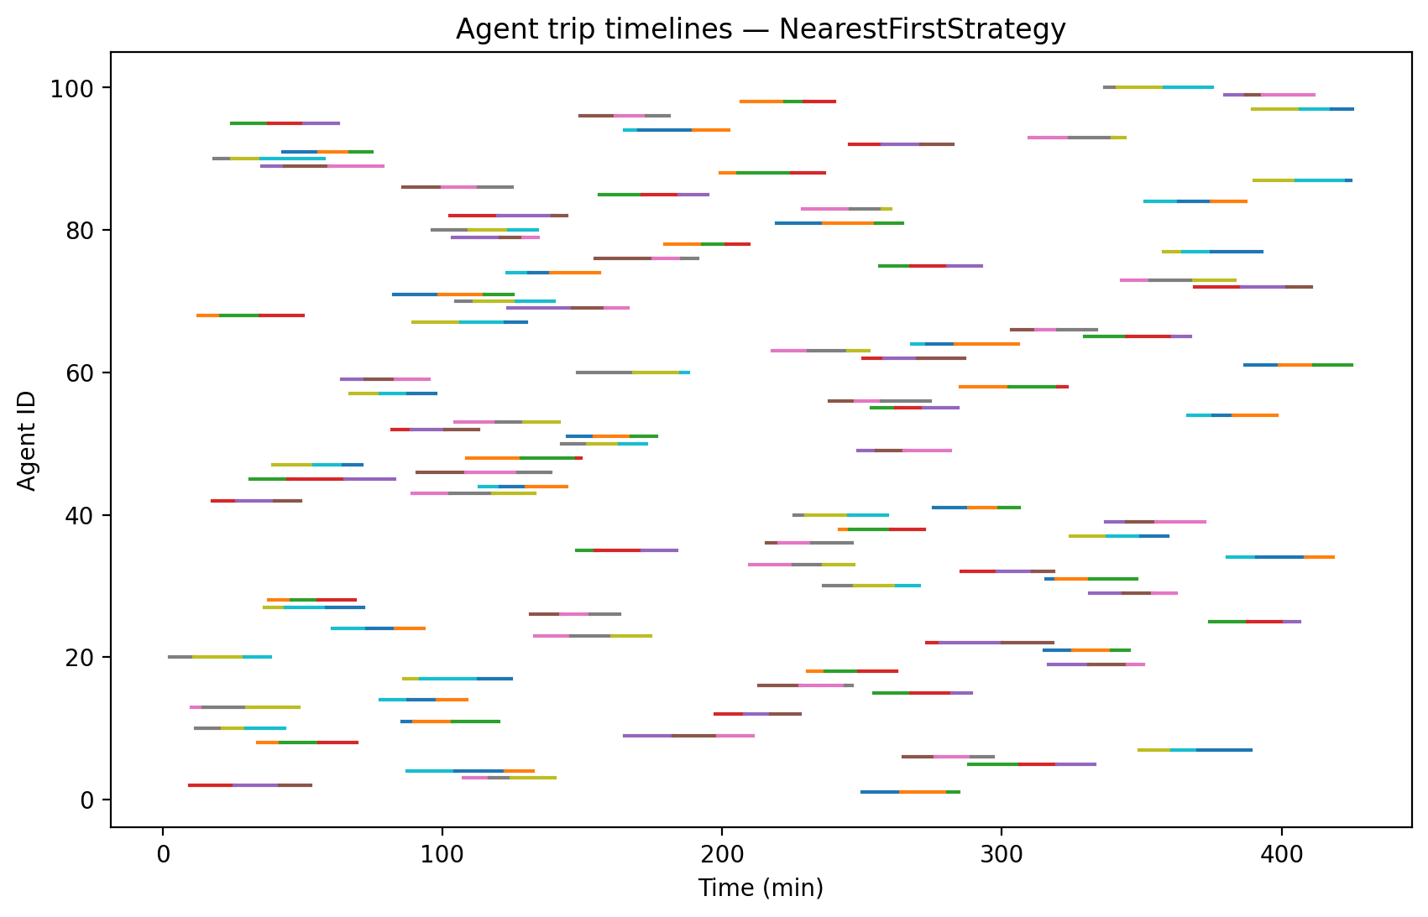
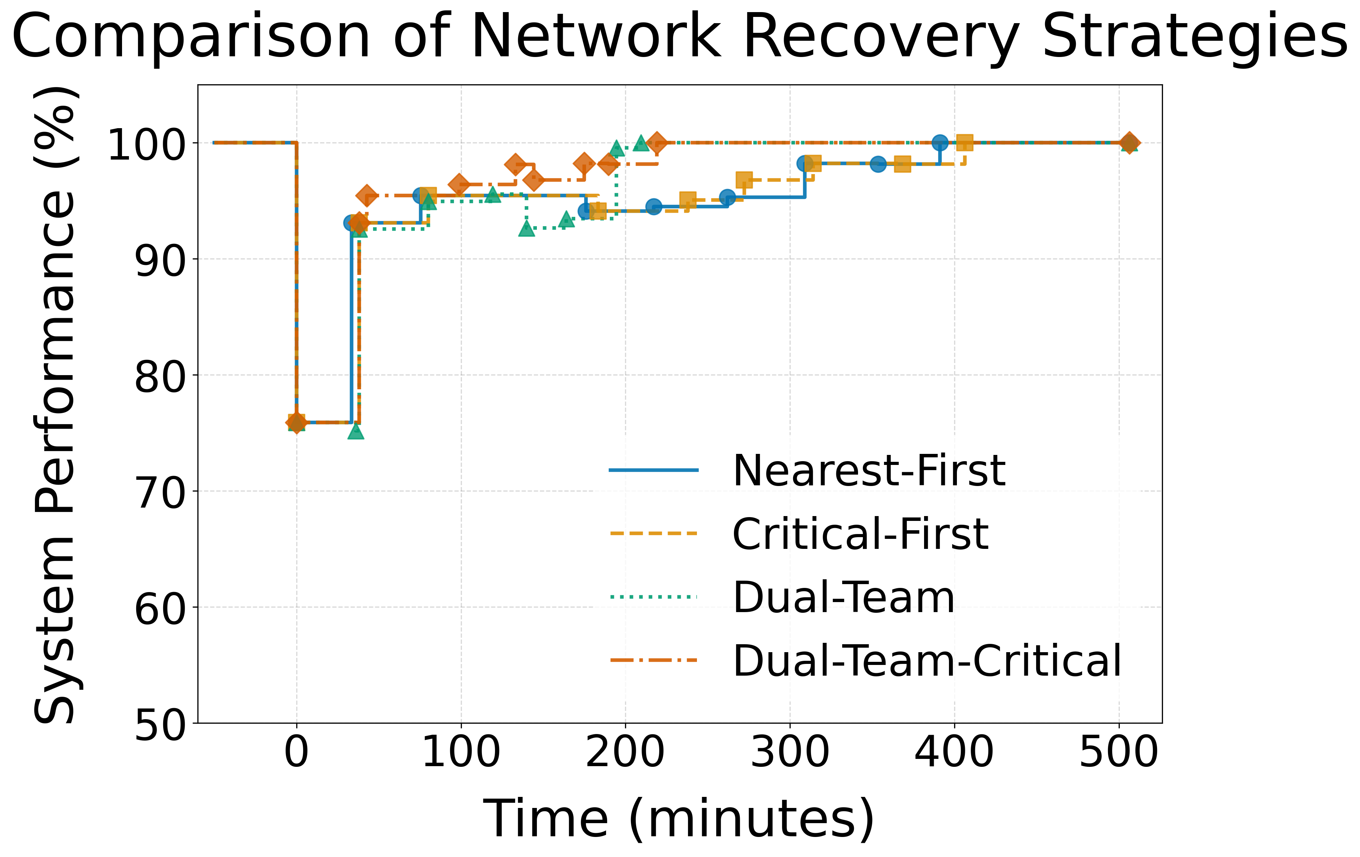
Recovery
Trip design from overall process

Slide 17
The complexity and inter-dependencies of urban systems
Flood
decelerate
Private Cars
short-circuited
activate
Public Transport
Node/Line
Operation
repair
Repairing Crews
Transport
Direct impact
Information flow

Slide 18
Private-Vehicle Agent Simulation
To evaluate how private-vehicle travelers are affected by the evolving road network during the damage–repair process, and compare four recovery strategies in terms of delays, accessibility, and completion rates.

Slide 19
Input Data
The agent simulation relies entirely on pre-computed outputs:
Dynamic OD snapshots outputsod_*.csv (Shortest-path travel times under the damaged network at multiple timestamps)
Damage & repair schedule edge_repairs.csv (Damage time, repair time for each affected edge)
Baseline OD matrix baseline_od_G_merged.csv (Shortest travel times on the intact network)
100 private-vehicle agents
Total: 400 agents across all strategies
Each agent represents one complete commuting-style trip.

Slide 20
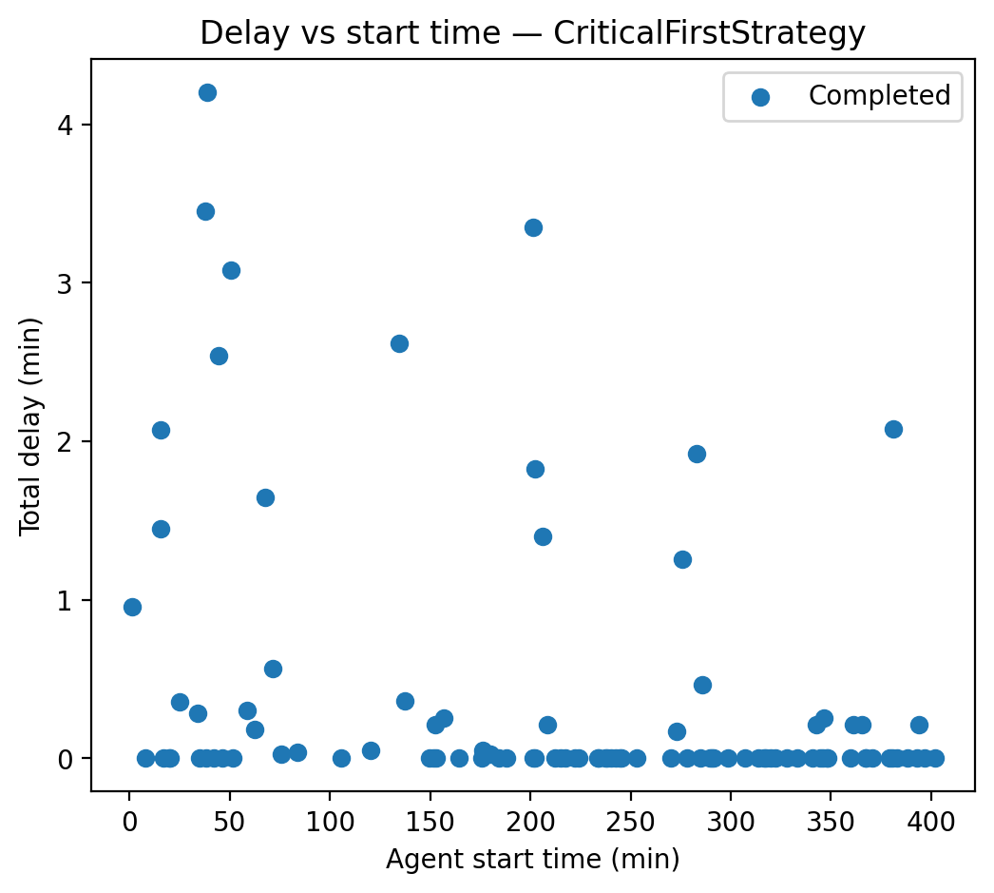
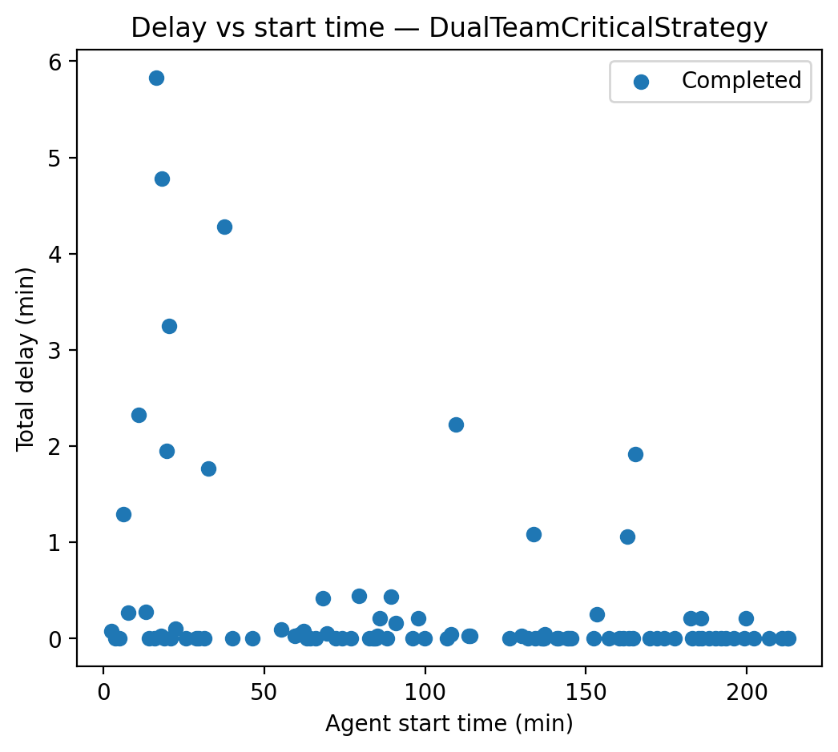
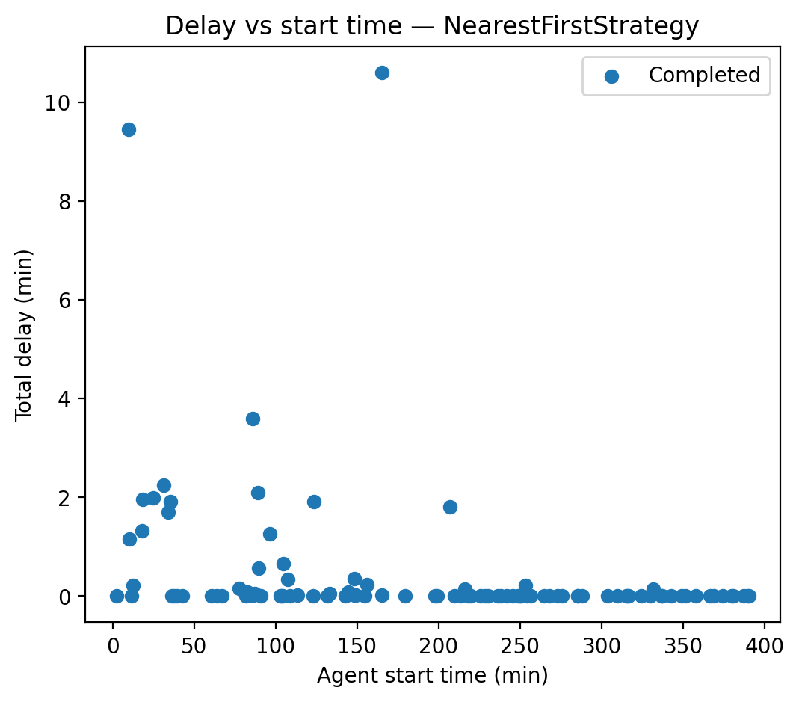
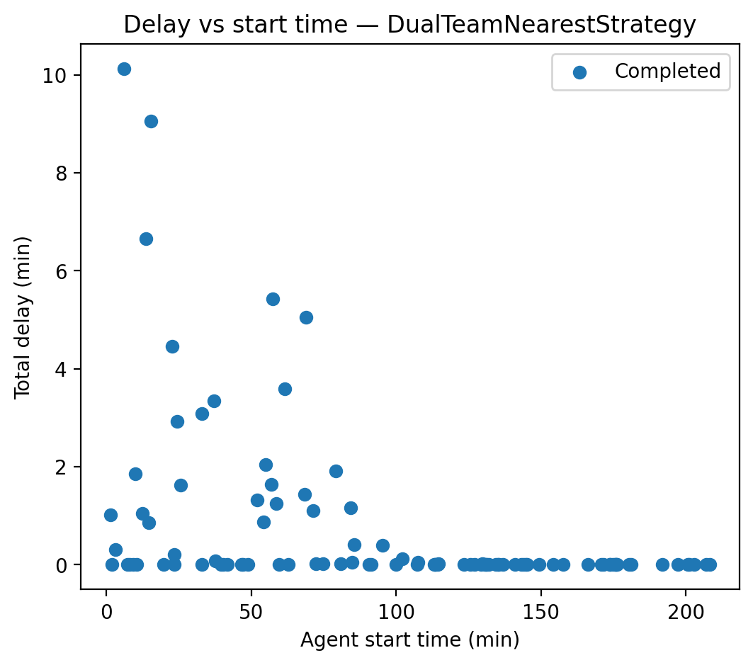
Delay vs. Departure Time
x-axis: departure time
y-axis: total delay
Completed agents plotted as points
Blocked agents plotted as “X” at zero delay

Slide 21
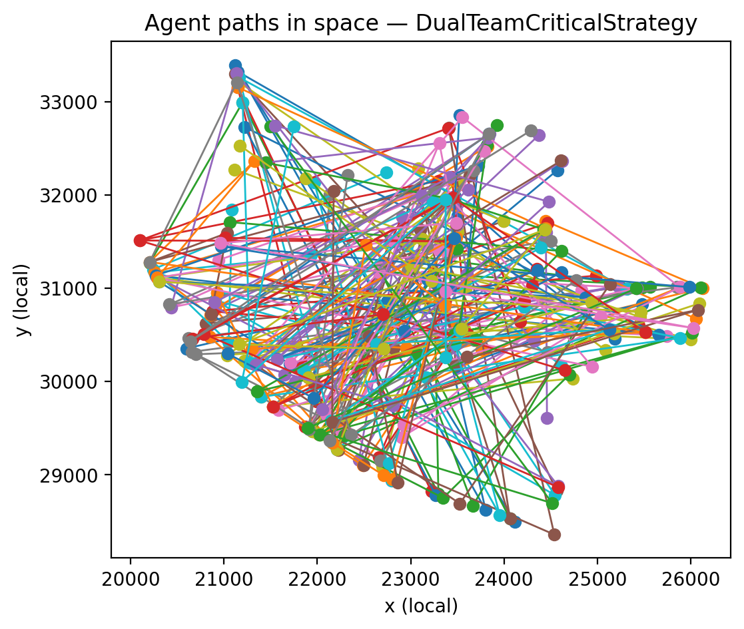
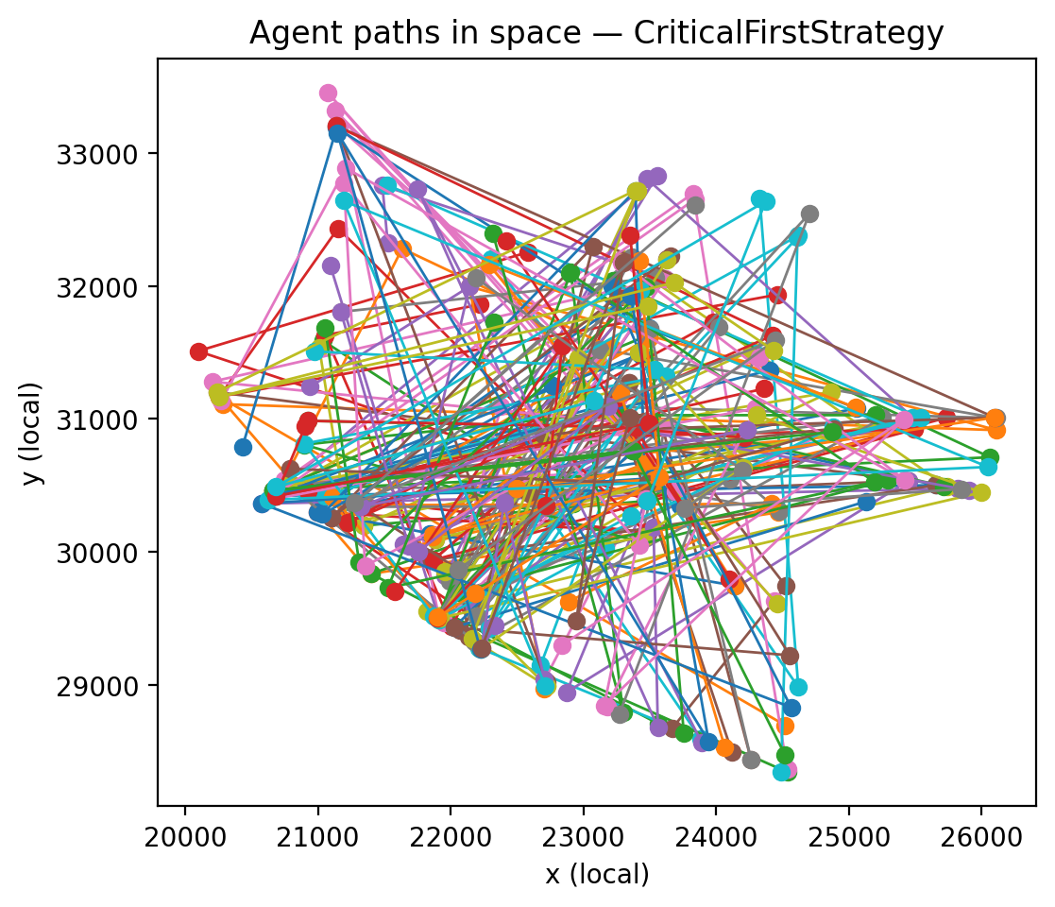
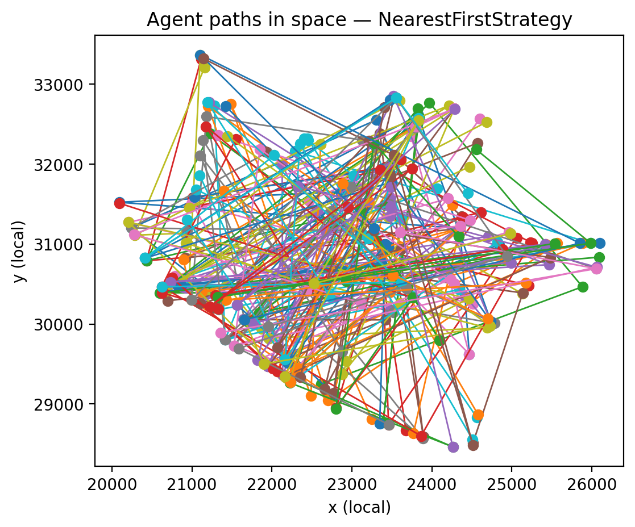
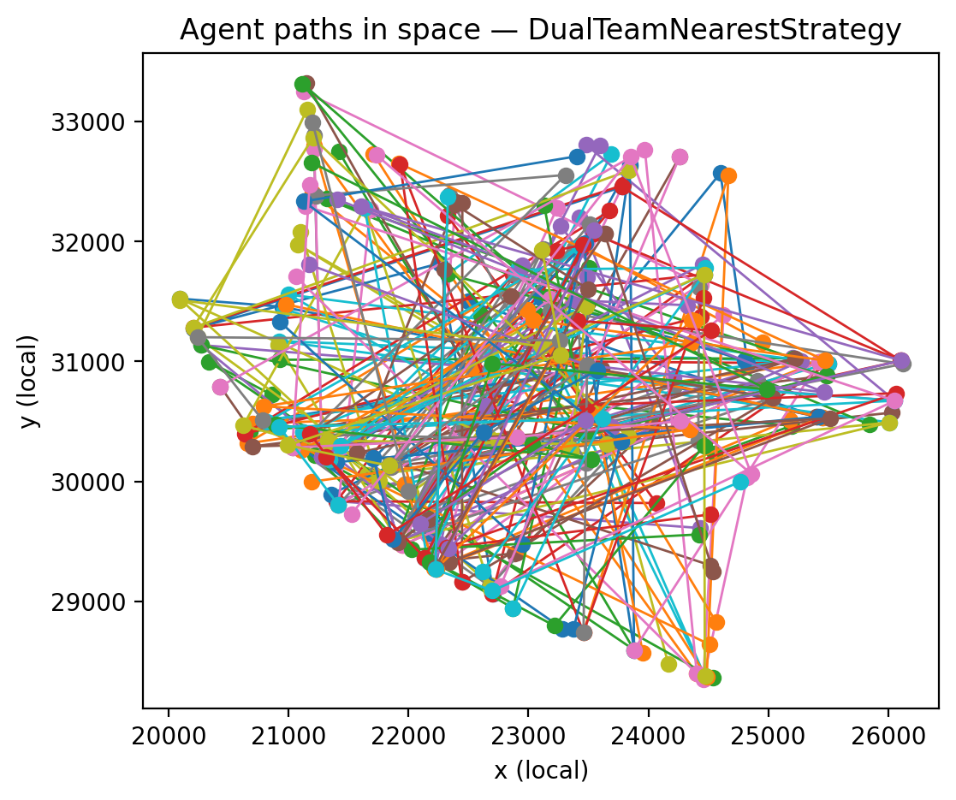
Spatial Footprint of Agent Paths
Many agents traverse damaged regions
Delays cluster around particular geographic zones
The OD sampling covers the entire area rather than only one corner

Slide 22
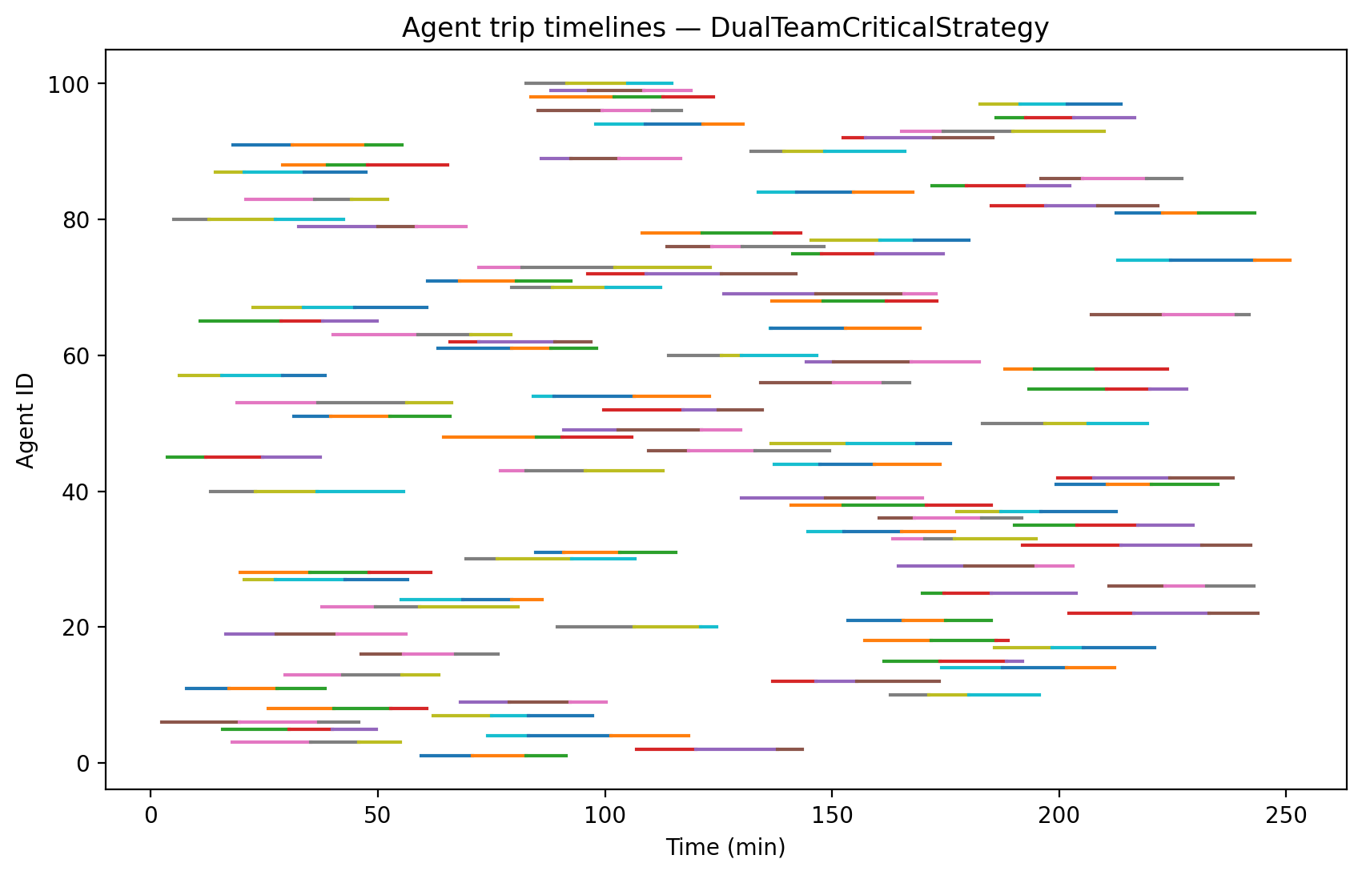
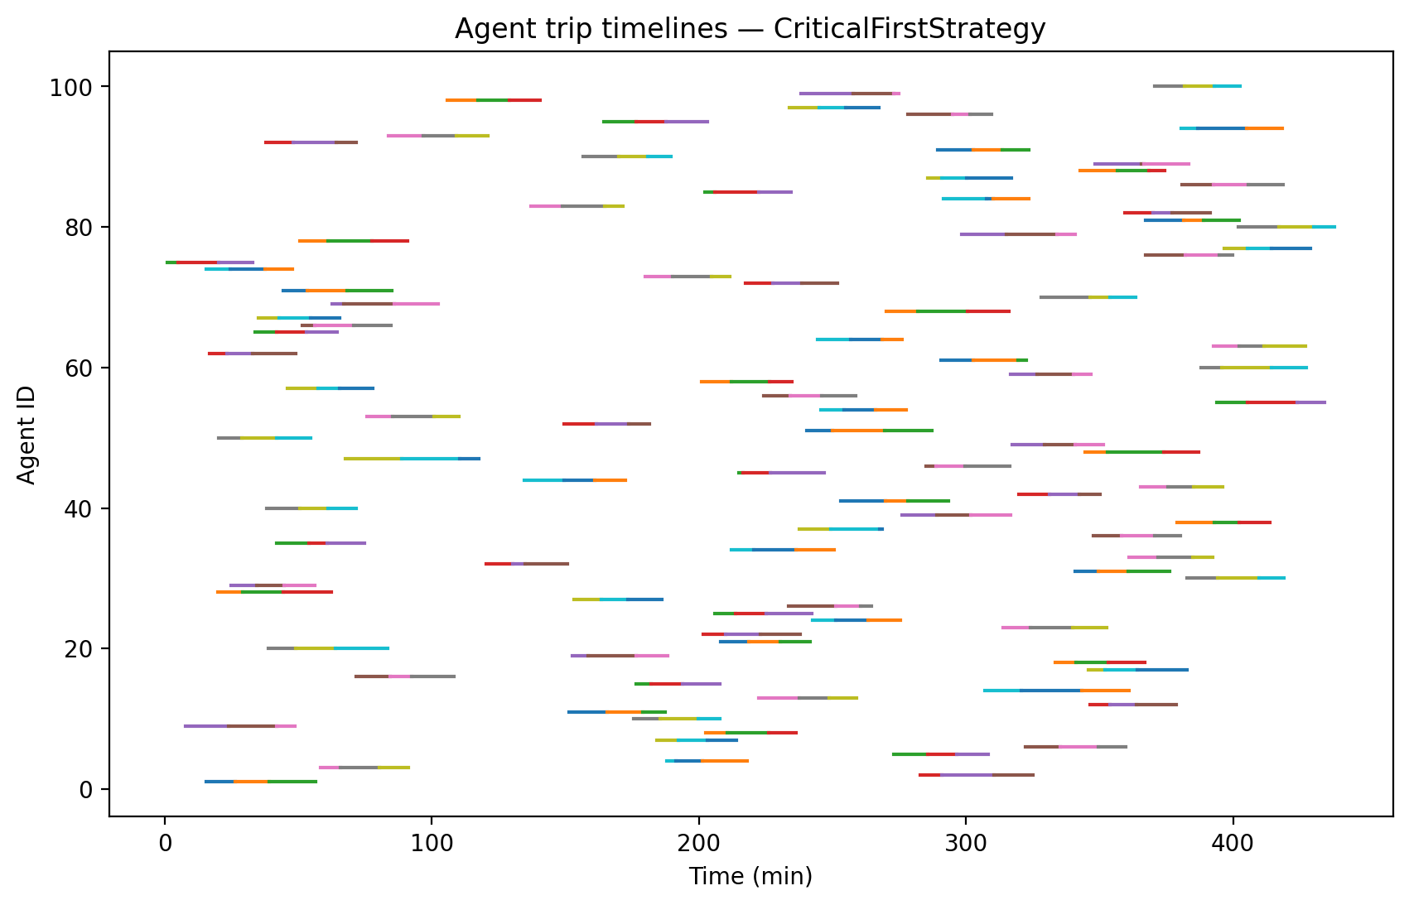
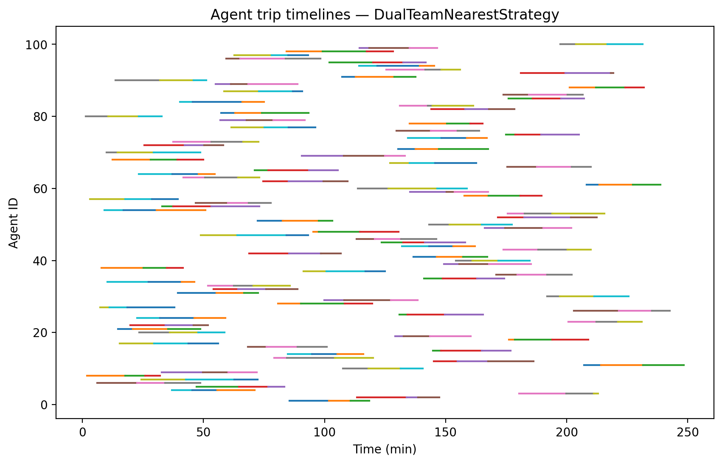
Agent Timelines (Trip Chronology)

Slide 23
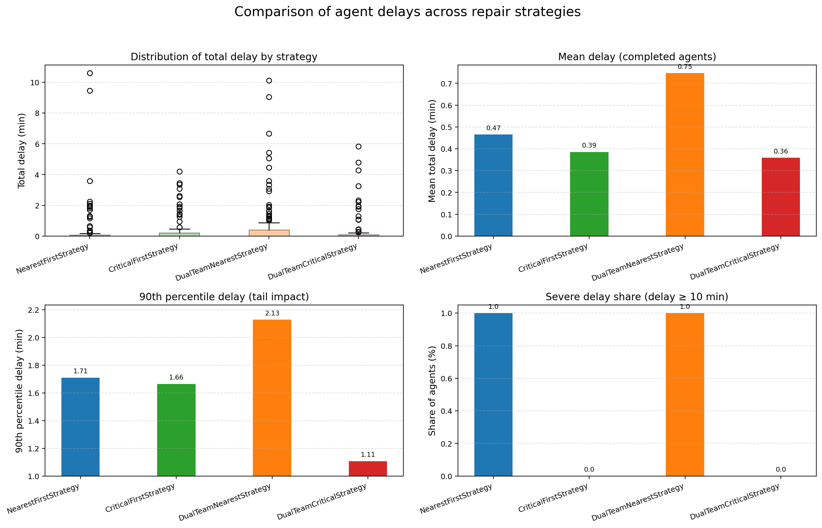

Slide 24
Bus Behaviour Model
Based on actual OD shortest paths, not synthetic paths
Dynamic interaction with real repair timelines
Integrates multi-leg transit behaviour
Compatible with agent simulation and strategy comparison

Slide 25
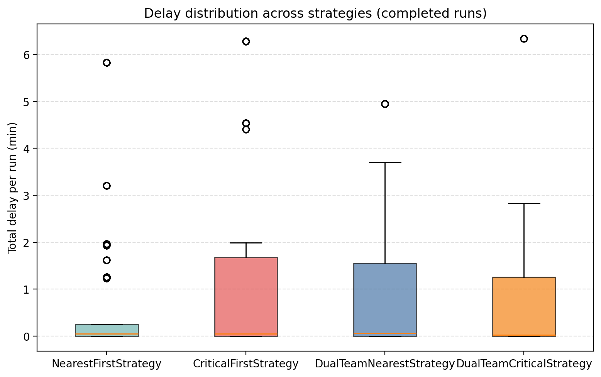
Bus Line Design
20 total lines
Each line is composed of 3 legs (A→B→C→D), sampled from baseline shortest paths
Line duration constraint: 30–60 minutes baseline travel time
Frequency: every 5 minutes
Schedule span: from t = 0 until last road repair time (≈ 390 min)
~80 runs per line → ~1600 runs per strategy
Each run carries a fixed/random number of passengers.
Purpose: ensure lines represent realistic commuter-scale routes that can be impacted by network disruptions.

Slide 26
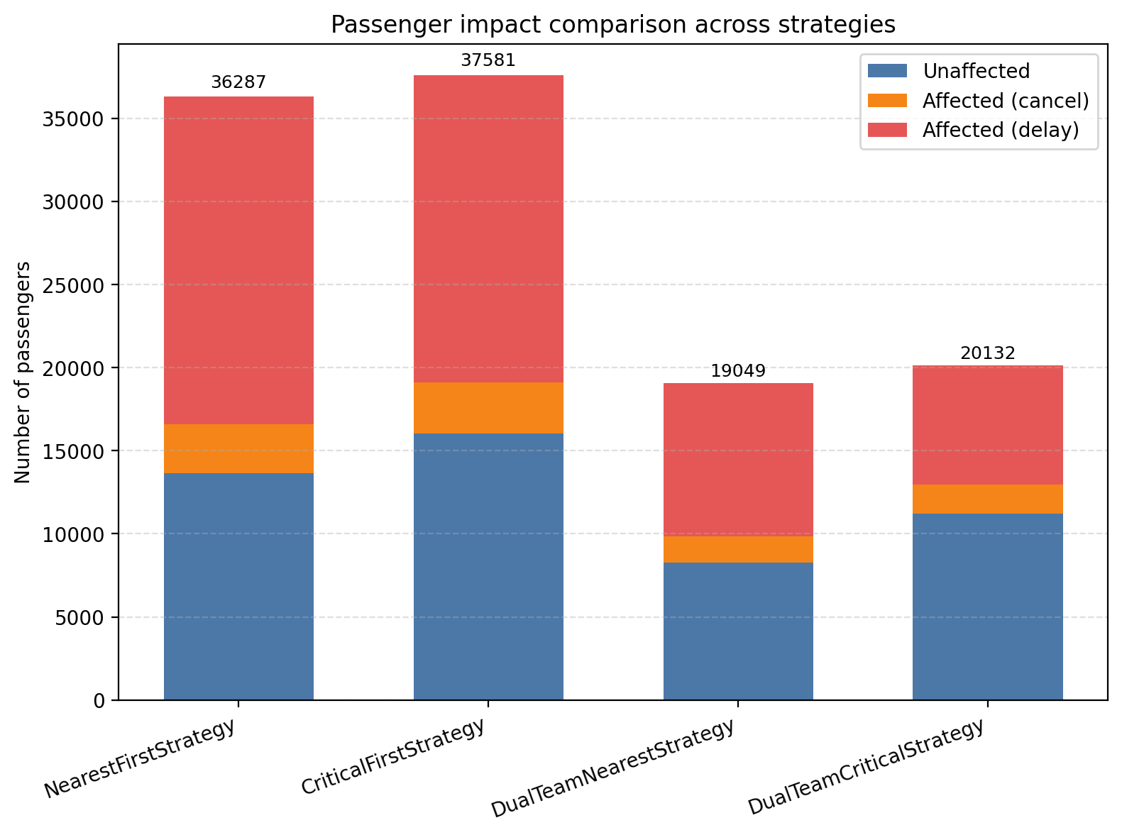
Select OD snapshot ≤ t as real-time network condition
Execute legs sequentially:
Lookup baseline and actual travel time
Compute delay: delay = max(actual − baseline, 0)
If any leg becomes unreachable in the snapshot: → Run cancelled → Entire passenger load counted as affected

Slide 27
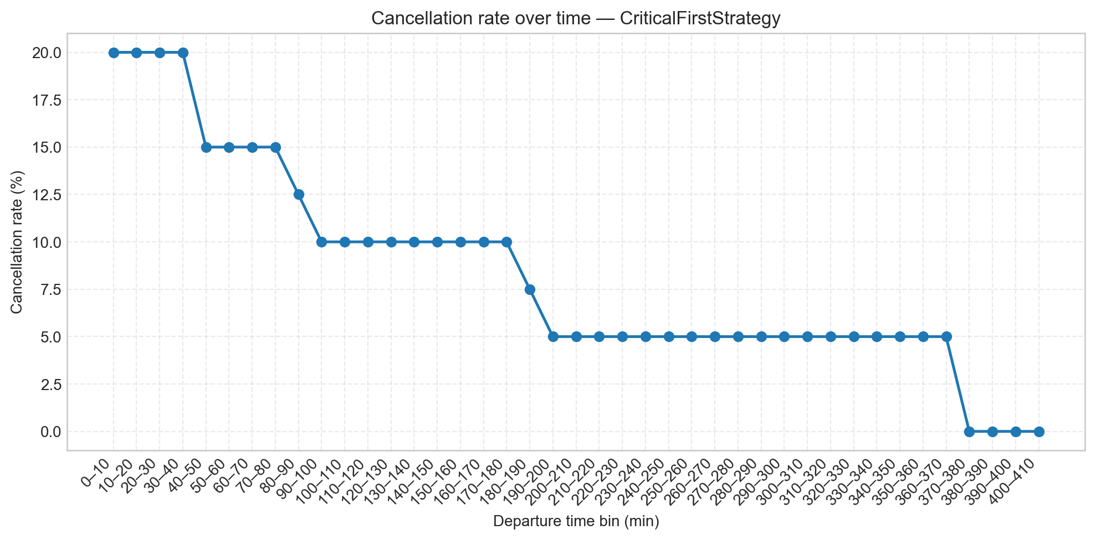
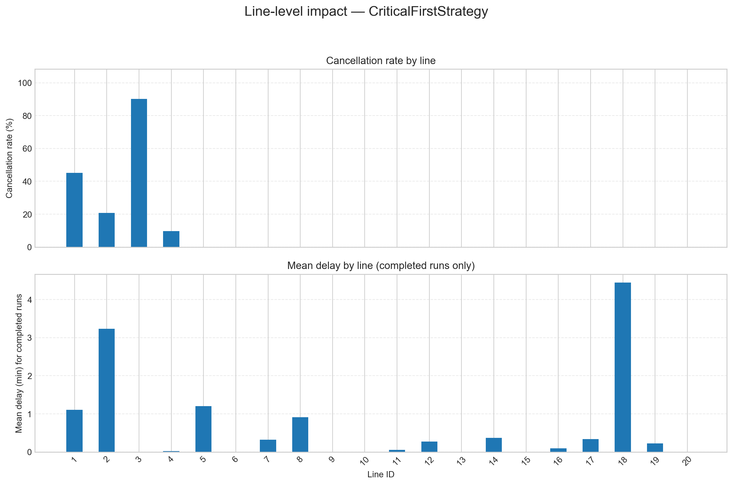

Slide 28
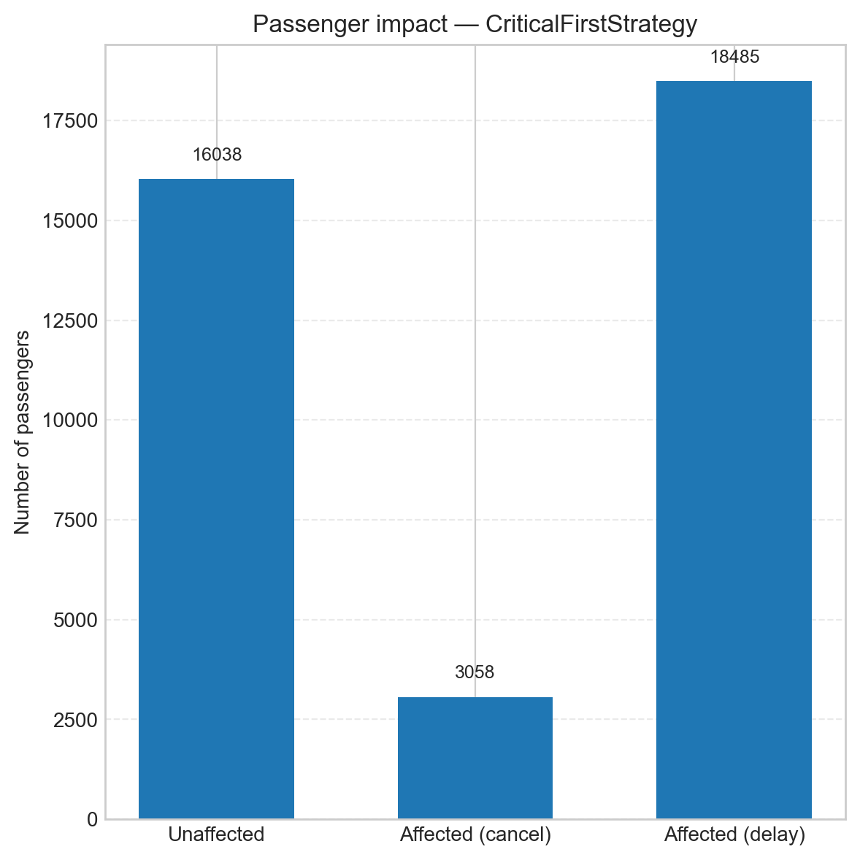
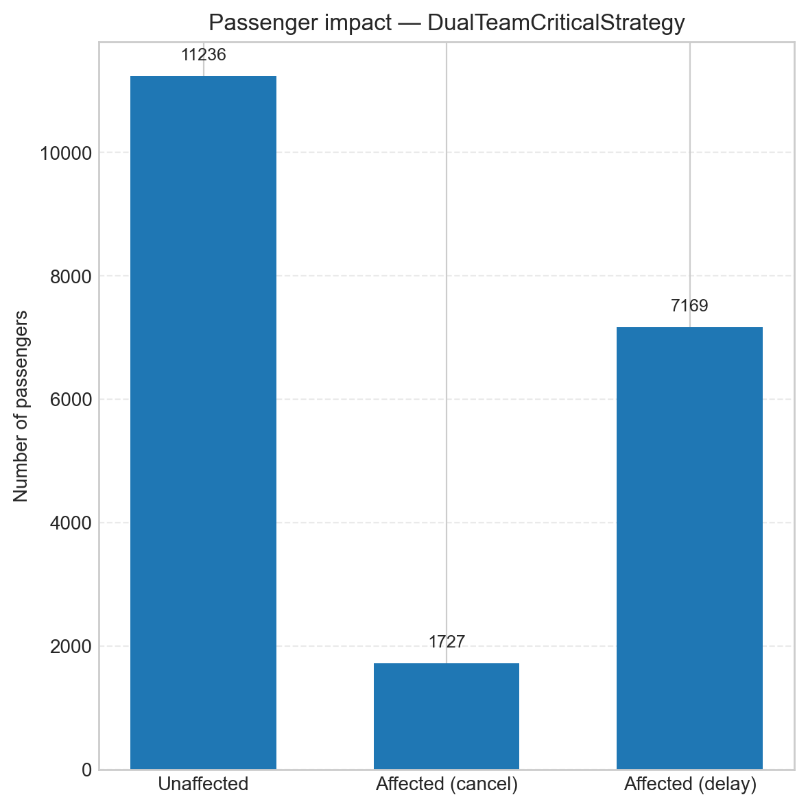
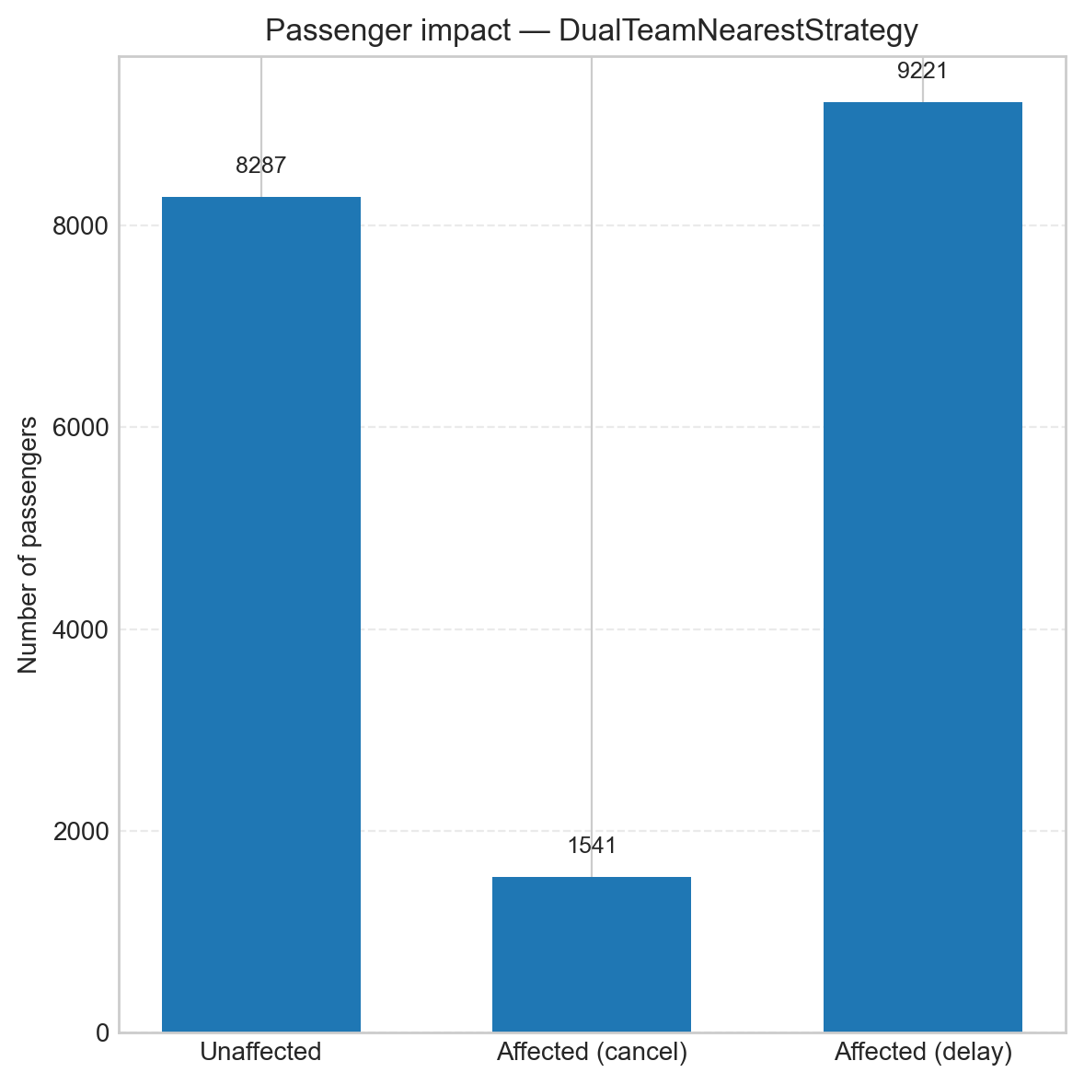
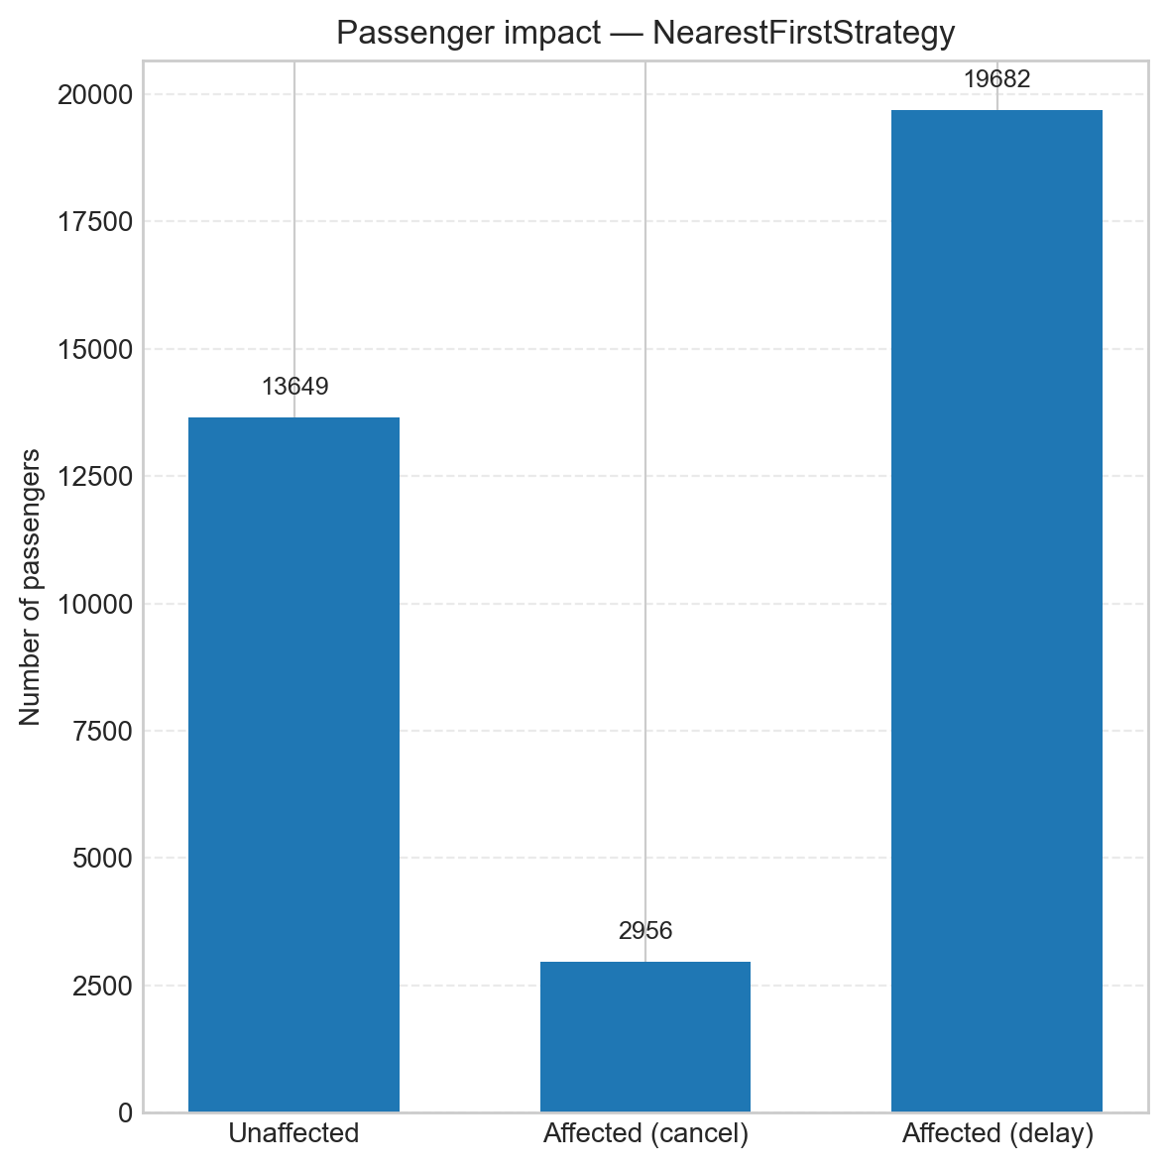

Slide 29
Repair Crews Engineering Crews as Agents
Each repair crew is modeled as an agent moving on the road network.
State: current position (node coordinates), repair speed, travel speed, and full movement history.
Behavior:
Travel: uses shortest-time paths on the current (partially repaired) network.
Preparation: adds a fixed 10-minute overhead before each new trip.
Repair: repair time depends on link length and difficulty; longer links are slower and penalized more.

Slide 30
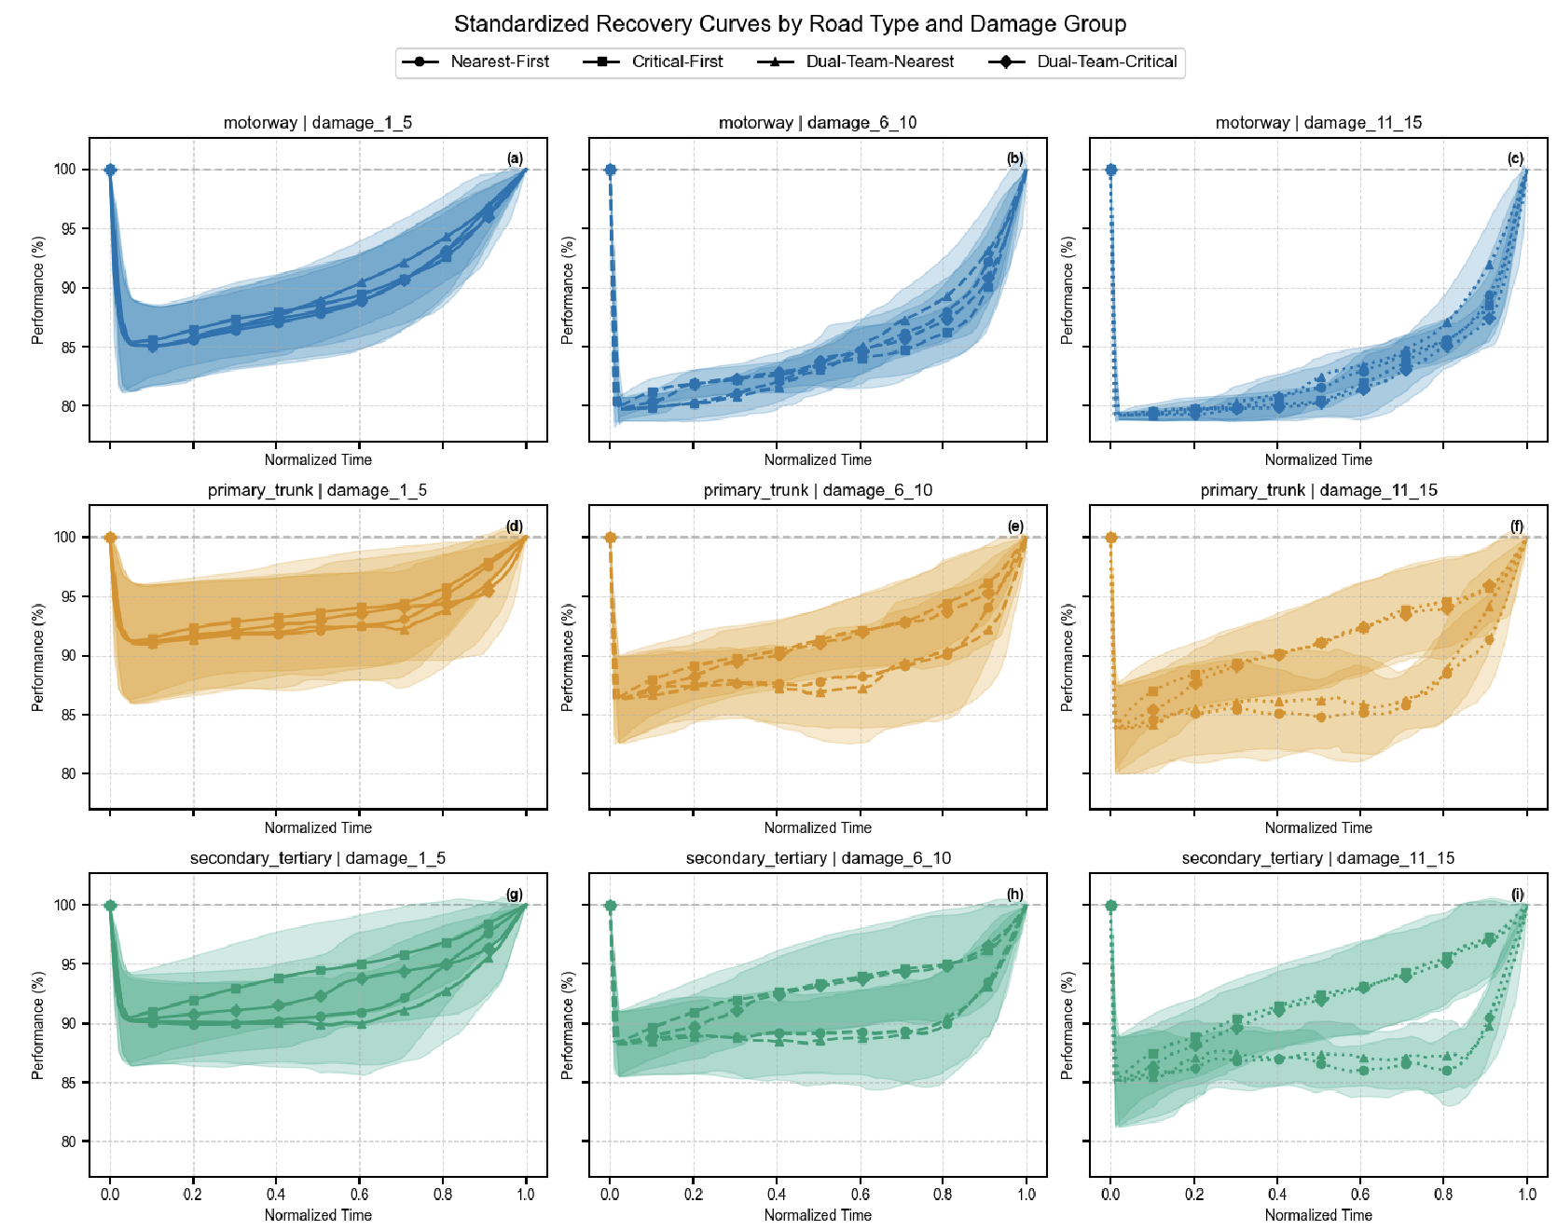
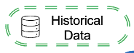

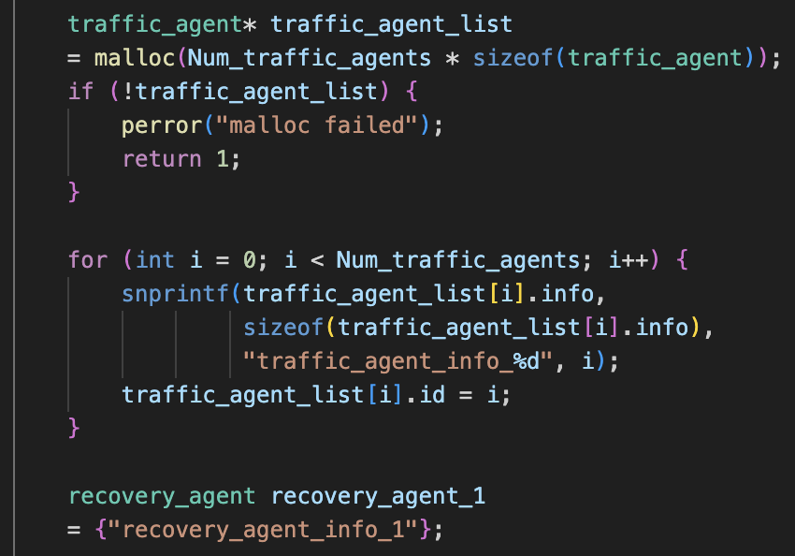
Model Validation
Previous Work
Comparison
Inputs
Outputs

Slide 31
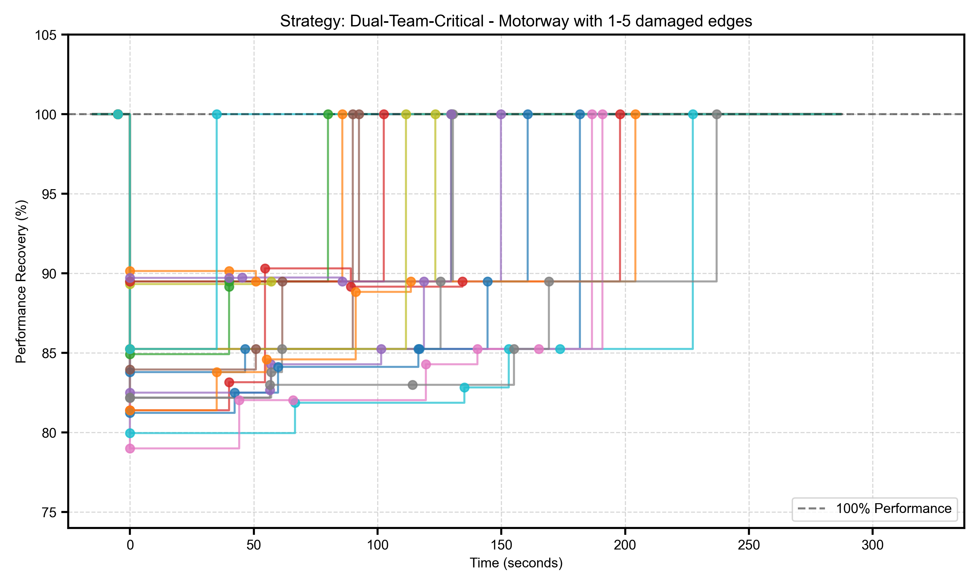
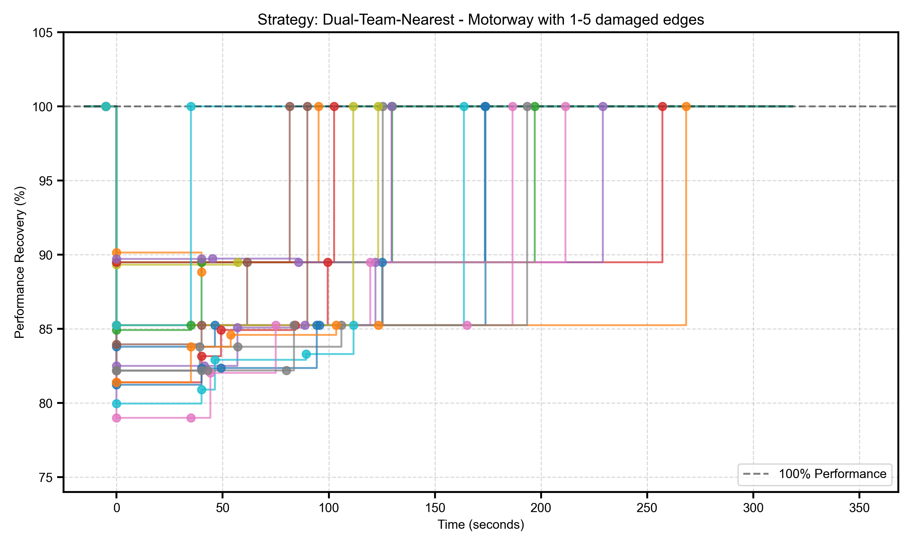
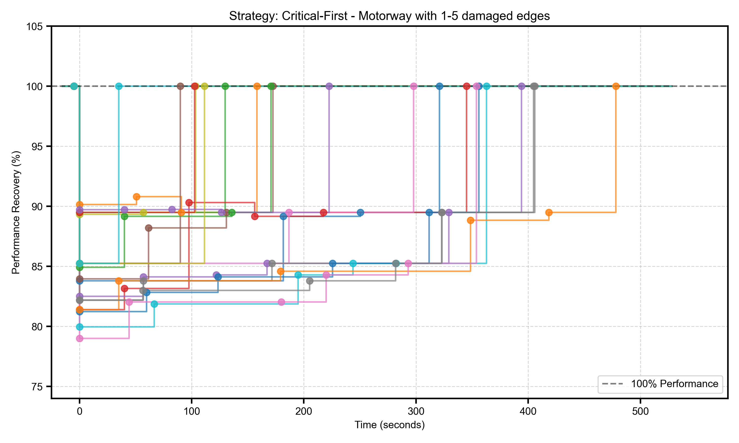
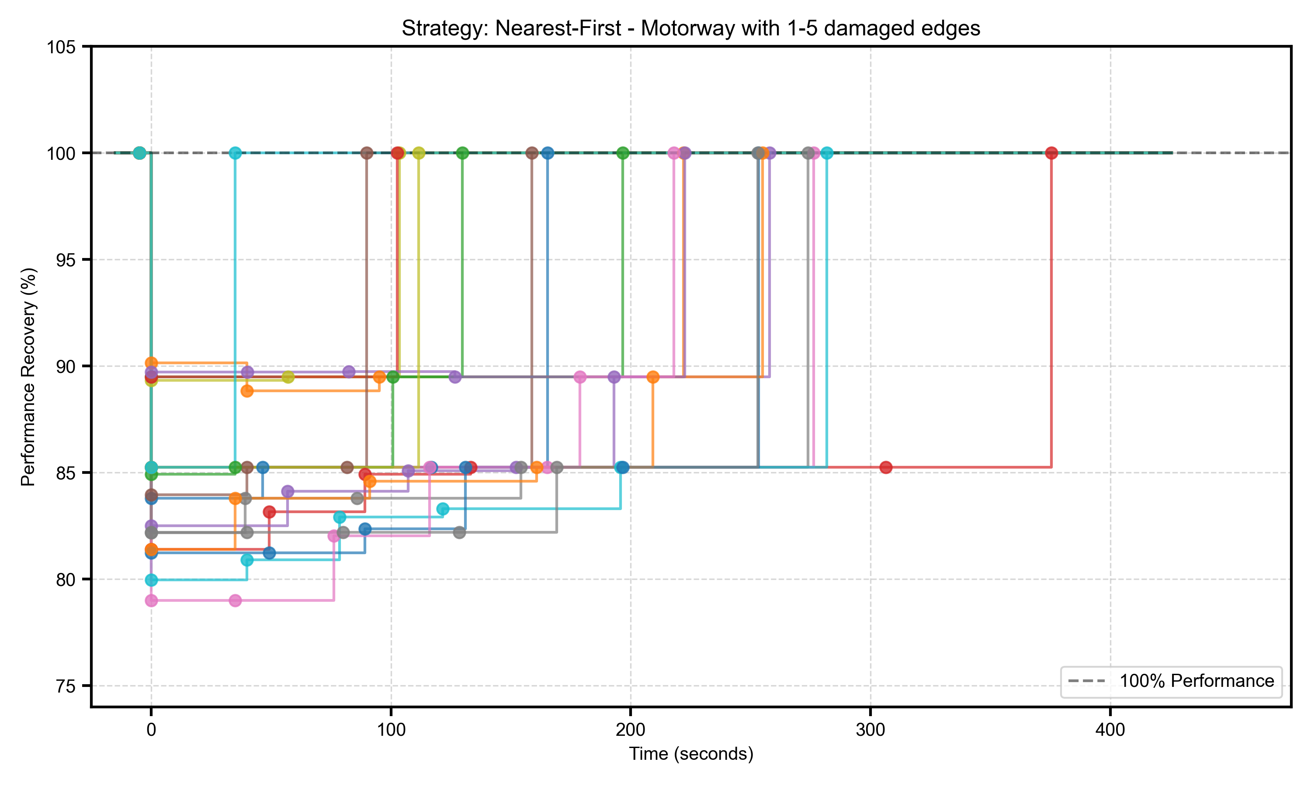
Stratified Monte-Carlo computer experiment
Between-scenario uncertainty
Comparisons of Different Road Types
Damage-Level Strategies
Results from 960 Simulation Runs
Recovery Strategy

Slide 32
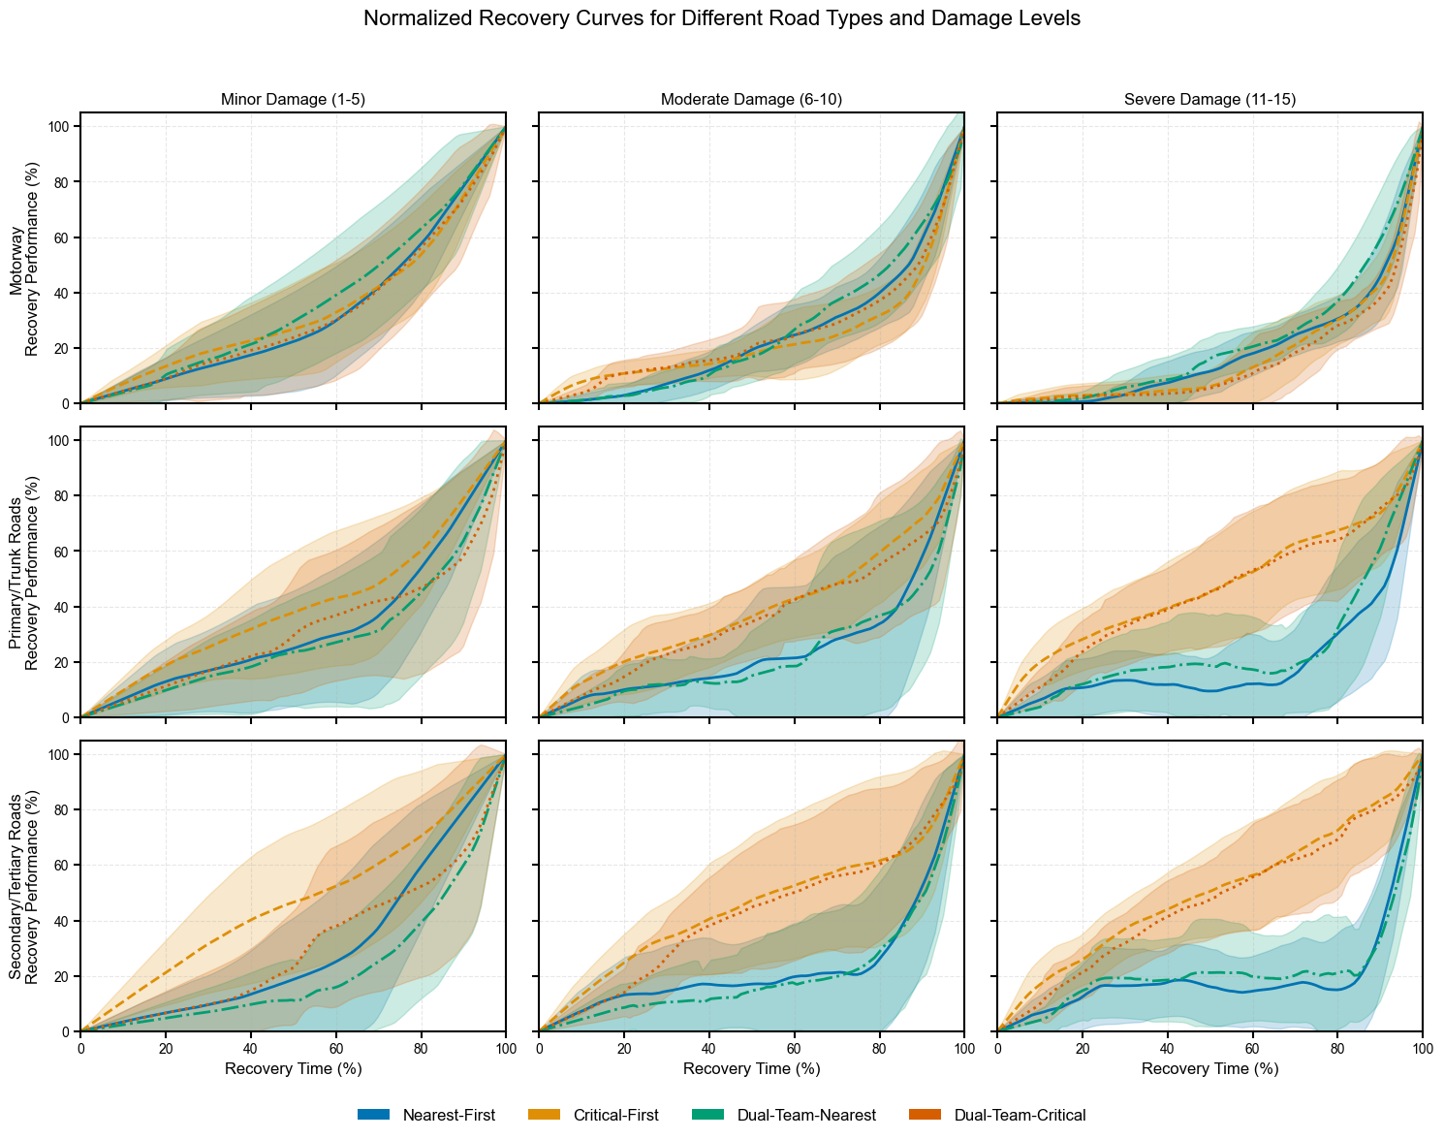

Slide 33






Flood–Traffic–Agent Simulation Framework
Flood model identifies top critical damaged road segments.
Four repair strategies executed: Nearest-First, Critical-First, Dual-Team-Nearest, Dual-Team-Critical.
Each strategy outputs time-stamped OD snapshots (od_*.csv) reflecting real-time network degradation & recovery.
Framework links: Flood → Road Failure → Repair Dynamics → User Impact (cars + buses)
Enables strategy comparison on:
Delay severity & distribution
Network accessibility over time
Passenger disruption & service resilience
Provides a scalable basis for extensions (multi-modal, economic loss, routing, LoD).

Slide 34
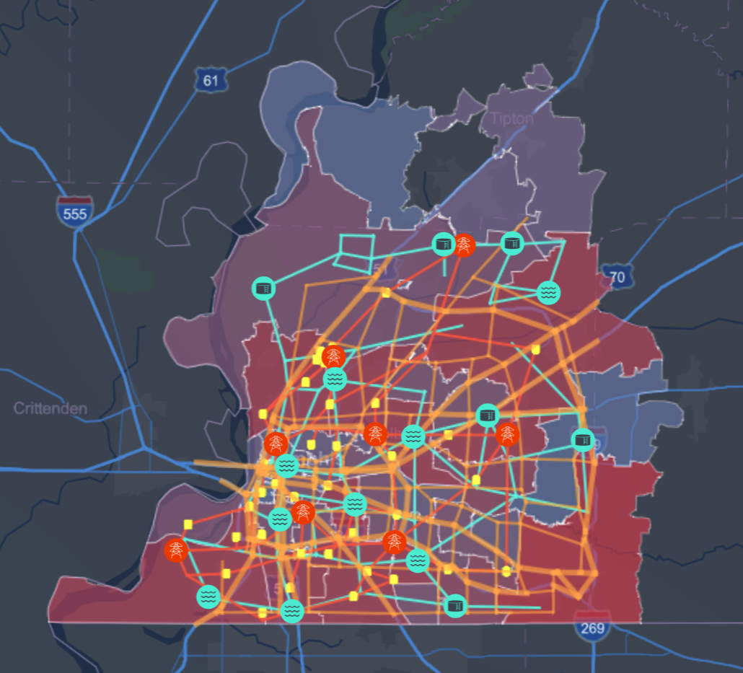
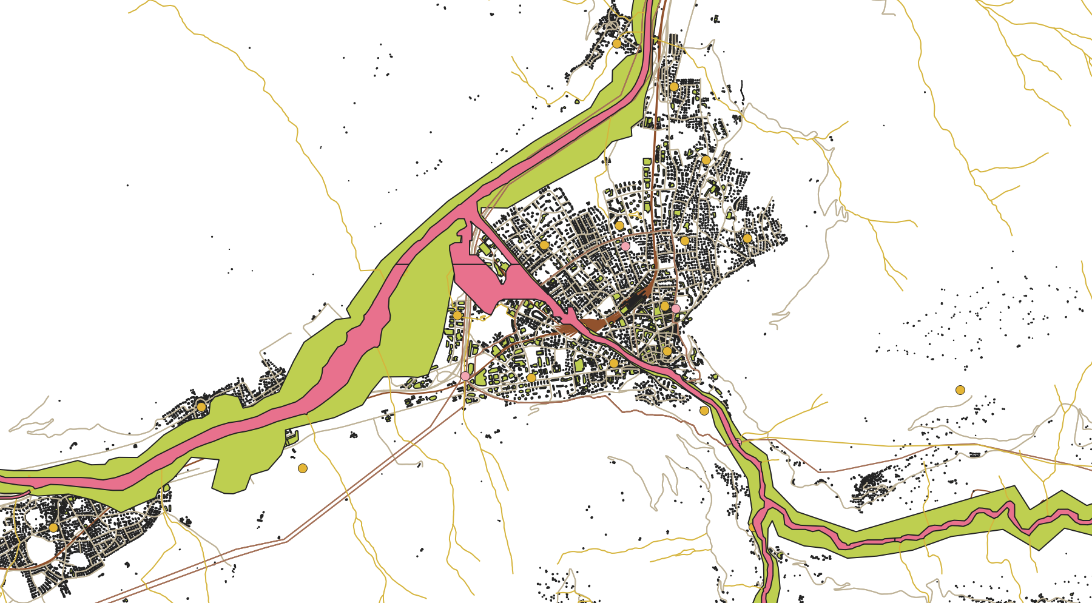
Infrarisk
Thank you
Chur

